Slide 1


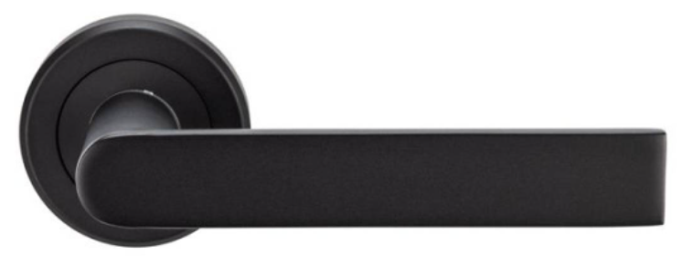




B1 L2 Princess Homes Subd. Novaliches, Quezon City  urbanity2022@gmail.com  927 361 2713
B1 L2 Princess Homes N
SZM210
SEROZZETTA™ EDGE Lever on Round Rose- Matt Black Finish
Lever on a concealed fix 2 part screw on round rose. The flat and rectangular design of the lever allows for ergonomic use and is easy to grip. A heavy robust no nonsense lever design for a busy environment. The chamfered edge concealed fix rose reflects the attention to detail in this range.

Slide 2

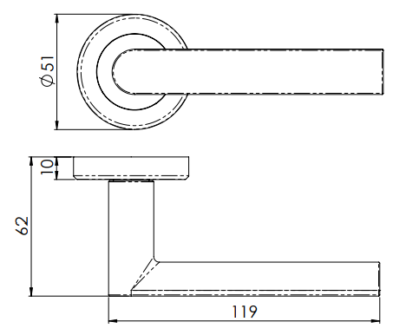




B1 L2 Princess Homes Subd. Novaliches, Quezon City  urbanity2022@gmail.com  927 361 2713
B1 L2 Princess Homes Subd. Novaliches, Quezon City  urbanity2022@gmail.com  927 361 2713
ITEM CODE | SZM210MB
MANUFACTURER | CARLISLE BRASS LTD UK
BRAND | ZEROZZETTA
AVAILABLE FINISH | MATT BLACK
TYPE | LEVER HANDLE
LENGTH | 119MM
PROJECTION | 62MM
ROSSETTE DIAMETER | 51MM
MECHANICAL WARRANTY | 10 YEARS

Slide 3
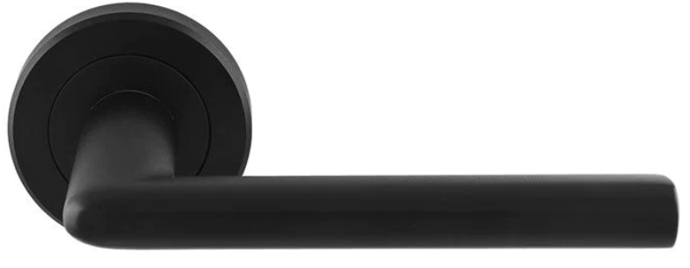
B1 L2 Princess Homes Subd. Novaliches, Quezon City  urbanity2022@gmail.com  927 361 2713
B1 L2 Princess Homes N
SZR010MB
SEROZZETTA™ DIECI Lever on Round Rose- Matt Black Finish
A lever on a chamfered edge concealed fix screw on round rose. A slender straight lever with smooth rounded edges forming a decreasing elliptical profile, a minimalist design. Part of the Serozzetta Residential range. Comes with a 10 year mechanical guarantee.

Slide 4
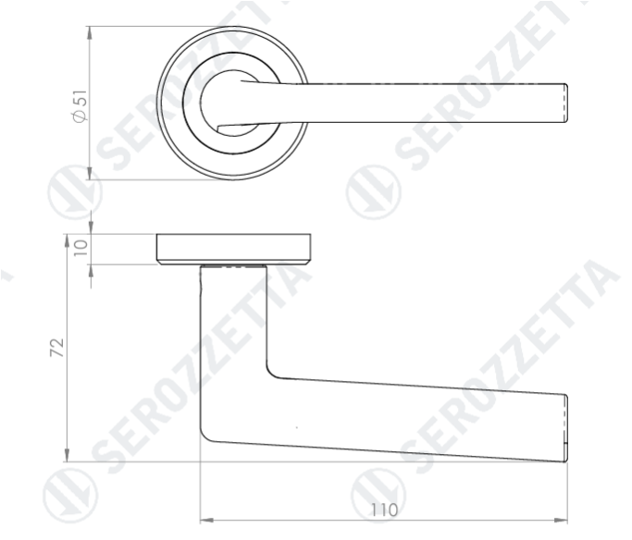
B1 L2 Princess Homes Subd. Novaliches, Quezon City  urbanity2022@gmail.com  927 361 2713
B1 L2 Princess Homes Subd. Novaliches, Quezon City  urbanity2022@gmail.com  927 361 2713
ITEM CODE | SZR010MB
MANUFACTURER | CARLISLE BRASS LTD UK
BRAND | ZEROZZETTA
AVAILABLE FINISH | MATT BLACK
TYPE | LEVER HANDLE
LENGTH | 110MM
PROJECTION | 72MM
ROSSETTE DIAMETER | 51MM
MECHANICAL WARRANTY | 10 YEARS

Slide 5
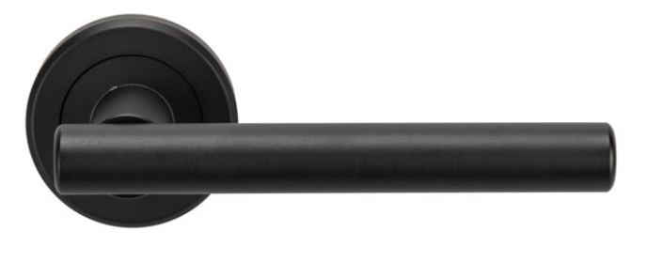
B1 L2 Princess Homes Subd. Novaliches, Quezon City  urbanity2022@gmail.com  927 361 2713
B1 L2 Princess Homes N
SEROZZETTA™ PHILADELPHIA Lever on Round Rose- Matt Black Finish
ZIN3121MB
Lever on a concealed fix 2 part screw on round rose. A straight round bar lever on rose. Part of the Serozzetta Zin lever designer collection. Comes with a 10 year mechanical guarantee and is fire door rated. Suitable for domestic and commercial use.

Slide 6
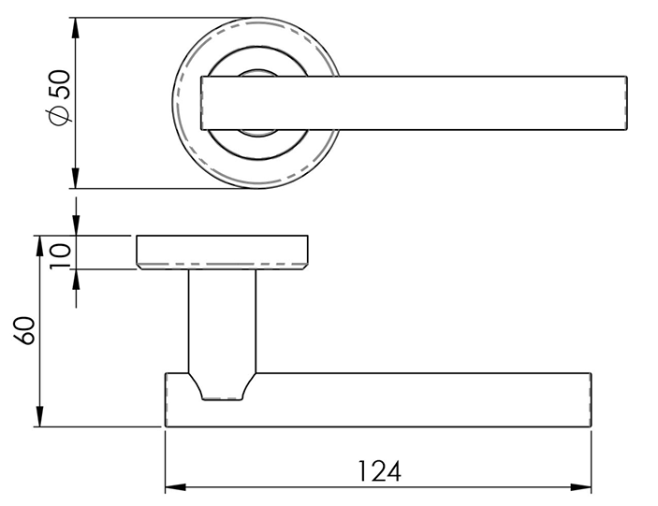
B1 L2 Princess Homes Subd. Novaliches, Quezon City  urbanity2022@gmail.com  927 361 2713
B1 L2 Princess Homes Subd. Novaliches, Quezon City  urbanity2022@gmail.com  927 361 2713
ITEM CODE | ZIN3121MB
MANUFACTURER | CARLISLE BRASS LTD UK
BRAND | ZEROZZETTA
AVAILABLE FINISH | MATT BLACK
TYPE | LEVER HANDLE
LENGTH | 124MM
PROJECTION | 60MM
ROSSETTE DIAMETER | 50MM
MECHANICAL WARRANTY | 10 YEARS

Slide 7

B1 L2 Princess Homes Subd. Novaliches, Quezon City  urbanity2022@gmail.com  927 361 2713
B1 L2 Princess Homes N
SZM001MB
SEROZZETTA™ EUROPROFILE ESCUTCHEON
Round escutcheon with a chamfered edge, screw on rose, concealed fix. Available in Standard & Euro lock profile. Designed to match the range of Serozzetta SZM designer handles on round roses.

Slide 8
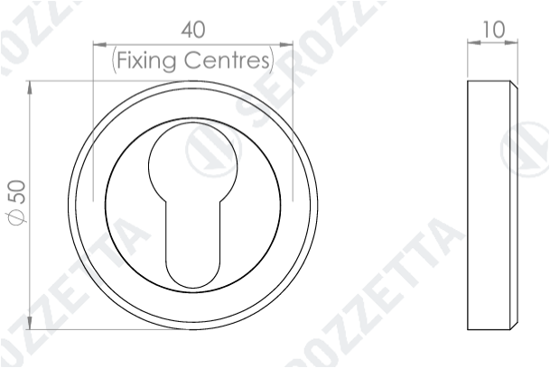
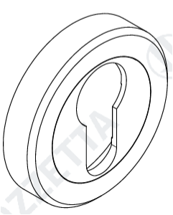
B1 L2 Princess Homes Subd. Novaliches, Quezon City  urbanity2022@gmail.com  927 361 2713
B1 L2 Princess Homes Subd. Novaliches, Quezon City  urbanity2022@gmail.com  927 361 2713
ITEM CODE | SZM001MB
MANUFACTURER | CARLISLE BRASS LTD UK
BRAND | ZEROZZETTA
AVAILABLE FINISH | MATT BLACK
TYPE | ESCUTCHEON
DIAMETER | 50MM
PROJECTION | 10MM
MECHANICAL WARRANTY | 10 YEARS

Slide 9
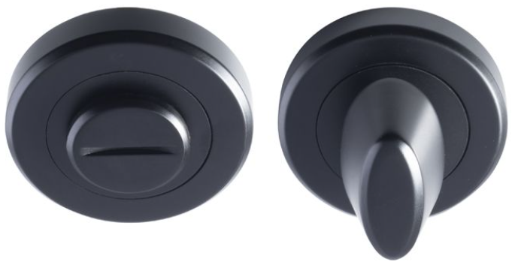
B1 L2 Princess Homes Subd. Novaliches, Quezon City  urbanity2022@gmail.com  927 361 2713
B1 L2 Princess Homes N
SZM004MB
SEROZZETTA™ THUMBTURN AND RELEASE ON ROSE
Thumbturn and release on a chamfered edge, screw on rose, concealed fix. Designed to match the range of Serozzetta SZM designer handles on round roses. Comes with a 10 year mechanical guarantee and is suitable for domestic and commercial use.

Slide 10
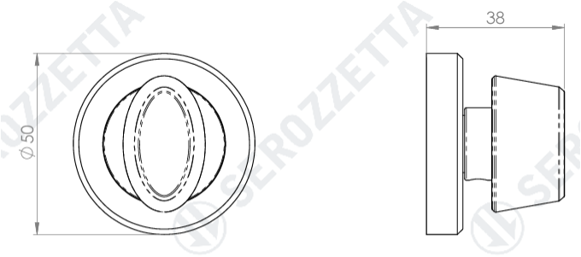
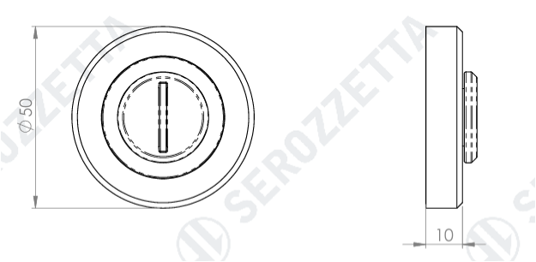
B1 L2 Princess Homes Subd. Novaliches, Quezon City  urbanity2022@gmail.com  927 361 2713
B1 L2 Princess Homes Subd. Novaliches, Quezon City  urbanity2022@gmail.com  927 361 2713
ITEM CODE | SZM004MB
MANUFACTURER | CARLISLE BRASS LTD UK
BRAND | ZEROZZETTA
AVAILABLE FINISH | MATT BLACK
TYPE | TURN AND RELEASE
DIAMETER | 50MM
PROJECTION | 38MM
MECHANICAL WARRANTY | 10 YEARS

Slide 11
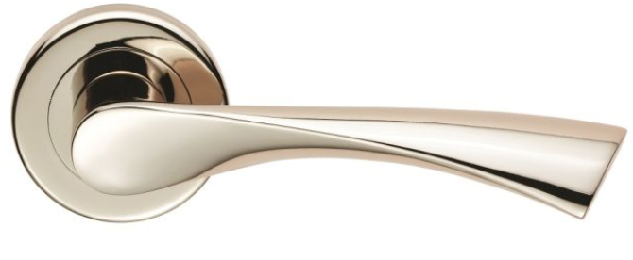
B1 L2 Princess Homes Subd. Novaliches, Quezon City  urbanity2022@gmail.com  927 361 2713
B1 L2 Princess Homes N
ZSR020PN
SEROZZETTA ™ VENTI LEVER ON ROSE
A Lever on a chamfered edge concealed fix screw on round rose. A stunning eye-catching design. The lever has an angular downward twist making it ergonomic in use as well as being extremely stylish. Part of the Serozzetta Residential range. Comes with a 10-year mechanical guarantee.

Slide 12
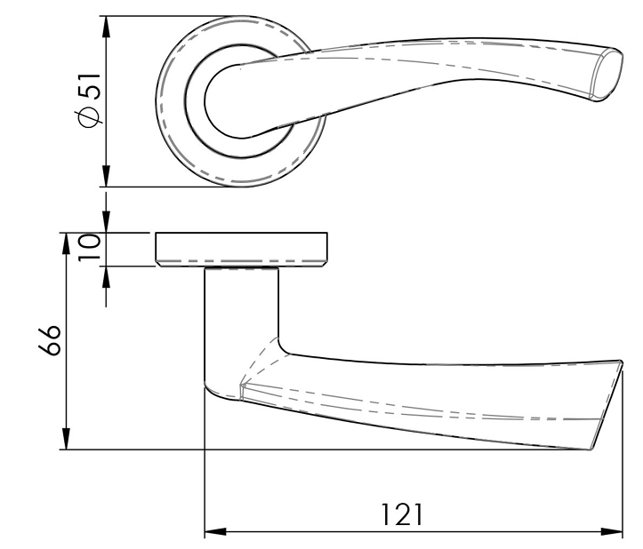
B1 L2 Princess Homes Subd. Novaliches, Quezon City  urbanity2022@gmail.com  927 361 2713
B1 L2 Princess Homes Subd. Novaliches, Quezon City  urbanity2022@gmail.com  927 361 2713
ITEM CODE | SZR020PN
MANUFACTURER | CARLISLE BRASS LTD UK
BRAND | ZEROZZETTA
AVAILABLE FINISH | POLISHED NICKEL
TYPE | LEVER HANDLE
LENGTH | 121MM
PROJECTION | 66MM
ROSSETTE DIAMETER | 51MM
MECHANICAL WARRANTY | 10 YEARS

Slide 13
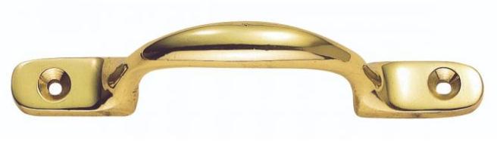
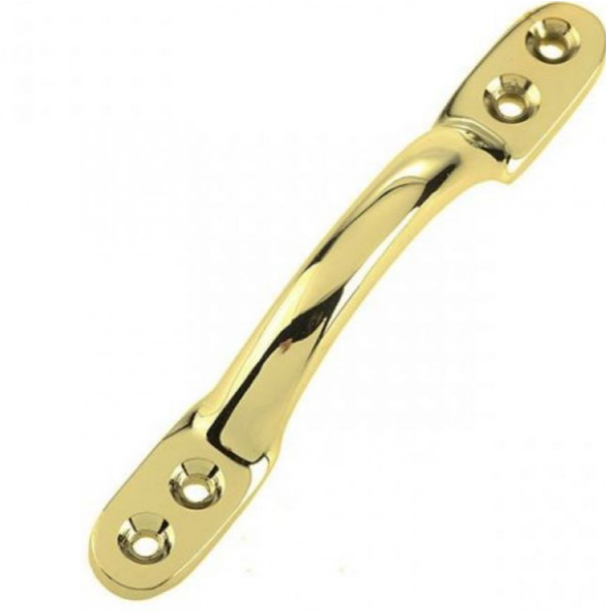

B1 L2 Princess Homes Subd. Novaliches, Quezon City  urbanity2022@gmail.com  927 361 2713
B1 L2 Princess Homes Subd. Novaliches, Quezon City  urbanity2022@gmail.com  927 361 2713
AA96
CARLISLE BRASS ™ SASH WINDOW HANDLE
A conventional and easy to use sash handle for moving sash windows up and down, or for other simple uses around the home such as cupboard door handles.

Slide 14
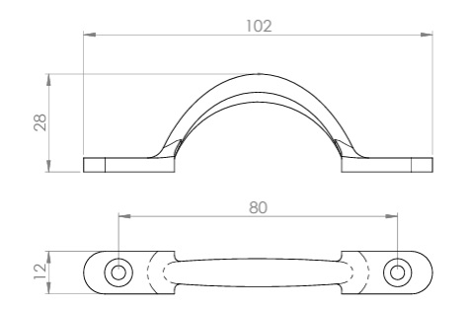
B1 L2 Princess Homes Subd. Novaliches, Quezon City  urbanity2022@gmail.com  927 361 2713
B1 L2 Princess Homes Subd. Novaliches, Quezon City  urbanity2022@gmail.com  927 361 2713
ITEM CODE | AA96
MANUFACTURER | CARLISLE BRASS LTD UK
BRAND | CARLISLE BRASS
AVAILABLE FINISH | POLISHED BRASS
TYPE | SASH WINDOW FITTING
LENGTH | 102MM
PROJECTION | 28MM
WIDTH | 12MM
MECHANICAL WARRANTY | 10 YEARS

Slide 15
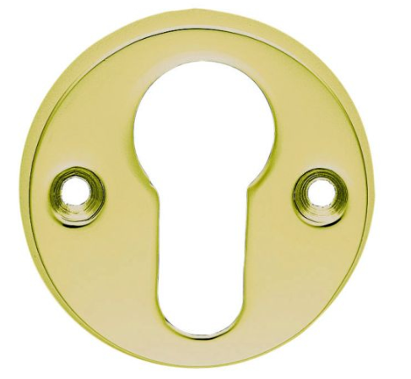

B1 L2 Princess Homes Subd. Novaliches, Quezon City  urbanity2022@gmail.com  927 361 2713
B1 L2 Princess Homes Subd. Novaliches, Quezon City  urbanity2022@gmail.com  927 361 2713
AA145
CARLISLE BRASS ™ EUROPROFILE ESCUTCHEON
Open plain, face fix Euro lock profile escutcheon on a robust 8mm deep base. (Face Fix)

Slide 16
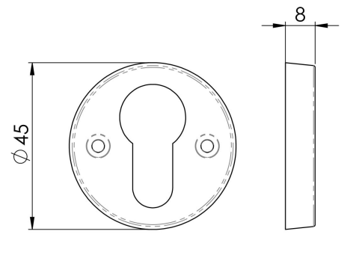
B1 L2 Princess Homes Subd. Novaliches, Quezon City  urbanity2022@gmail.com  927 361 2713
B1 L2 Princess Homes Subd. Novaliches, Quezon City  urbanity2022@gmail.com  927 361 2713
ITEM CODE | AA145
MANUFACTURER | CARLISLE BRASS LTD UK
BRAND | CARLISLE BRASS
AVAILABLE FINISH | POLISHED BRASS
TYPE | ESCUTCHEON
DIAMETER | 145MM
PROJECTION | 8MM
MECHANICAL WARRANTY | 10 YEARS

Slide 17
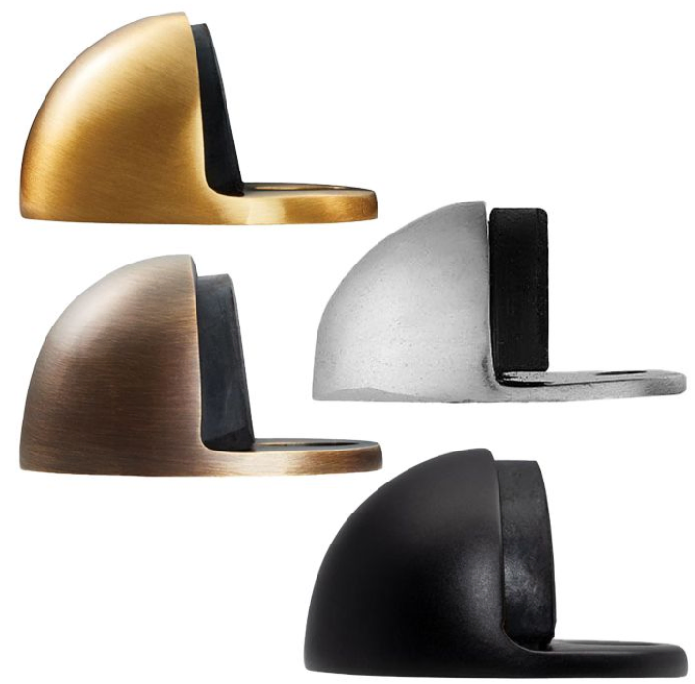

B1 L2 Princess Homes Subd. Novaliches, Quezon City  urbanity2022@gmail.com  927 361 2713
B1 L2 Princess Homes Subd. Novaliches, Quezon City  urbanity2022@gmail.com  927 361 2713
AA20
CARLISLE BRASS ™ FLOOR MOUNTED DOOR STOPPER
Also known as a half moon shaped door stop. Substantial rubber buffer fitted to the face which provides more than adequate protection for the door.

Slide 18
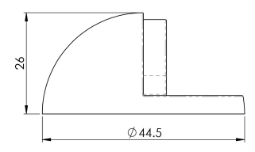
B1 L2 Princess Homes Subd. Novaliches, Quezon City  urbanity2022@gmail.com  927 361 2713
B1 L2 Princess Homes Subd. Novaliches, Quezon City  urbanity2022@gmail.com  927 361 2713
ITEM CODE | AA20
MANUFACTURER | CARLISLE BRASS LTD UK
BRAND | CARLISLE BRASS
AVAILABLE FINISH | MATT BLACK SATIN BRASS ANTIQUE BRASS
TYPE | DOOR STOPPER
DIAMETER | 44.5MM
PROJECTION | 26MM
MECHANICAL WARRANTY | 10 YEARS

Slide 19
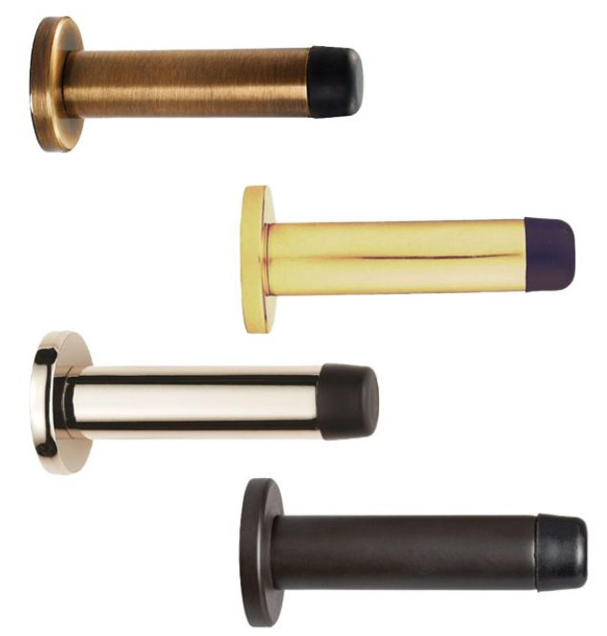

B1 L2 Princess Homes Subd. Novaliches, Quezon City  urbanity2022@gmail.com  927 361 2713
B1 L2 Princess Homes Subd. Novaliches, Quezon City  urbanity2022@gmail.com  927 361 2713
AA21
CARLISLE BRASS ™ CYLINDER PATTERN DOOR STOP ON ROSE
A slimline and elegant rubber buffer tipped door stop on rose. The base rose unscrews allowing it to be mounted to the wall or skirting board. The main body is then screwed back on for a neat concealed fit.

Slide 20
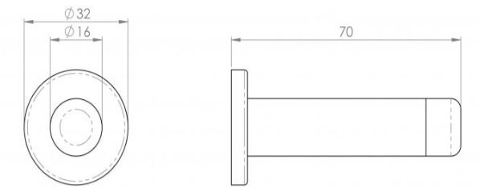
B1 L2 Princess Homes Subd. Novaliches, Quezon City  urbanity2022@gmail.com  927 361 2713
B1 L2 Princess Homes Subd. Novaliches, Quezon City  urbanity2022@gmail.com  927 361 2713
ITEM CODE | AA21
MANUFACTURER | CARLISLE BRASS LTD UK
BRAND | CARLISLE BRASS
AVAILABLE FINISH | MATT BLACK SATIN BRASS ANTIQUE BRASS
TYPE | DOOR STOPPER
DIAMETER | ROSE : 32MM CYLINDER : 16MM
PROJECTION | 70MM
MECHANICAL WARRANTY | 10 YEARS

Slide 21
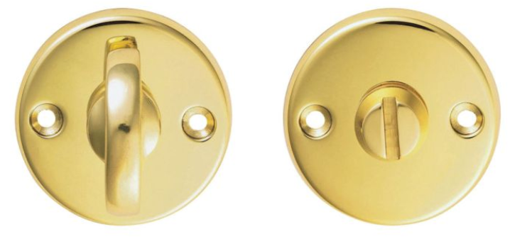

B1 L2 Princess Homes Subd. Novaliches, Quezon City  urbanity2022@gmail.com  927 361 2713
B1 L2 Princess Homes Subd. Novaliches, Quezon City  urbanity2022@gmail.com  927 361 2713
B12
CARLISLE BRASS ™ BATHROOM TURN AND RELEASE ON FACE-FIXED ROUND ROSE
Slim style turn and release on a robust 8mm thick rose for use with bathroom locks. Comes with a 10 year mechanical guarantee and is Fire door rated. Suitable for domestic and commercial use.

Slide 22
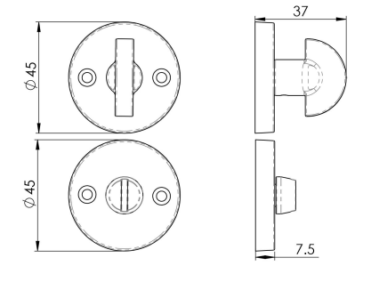
B1 L2 Princess Homes Subd. Novaliches, Quezon City  urbanity2022@gmail.com  927 361 2713
B1 L2 Princess Homes Subd. Novaliches, Quezon City  urbanity2022@gmail.com  927 361 2713
ITEM CODE | B12
MANUFACTURER | CARLISLE BRASS LTD UK
BRAND | CARLISLE BRASS
AVAILABLE FINISH | POLISHED BRASS
TYPE | TURN AND RELEASE
DIAMETER | 45MM
PROJECTION | 37MM
MECHANICAL WARRANTY | 10 YEARS

Slide 23
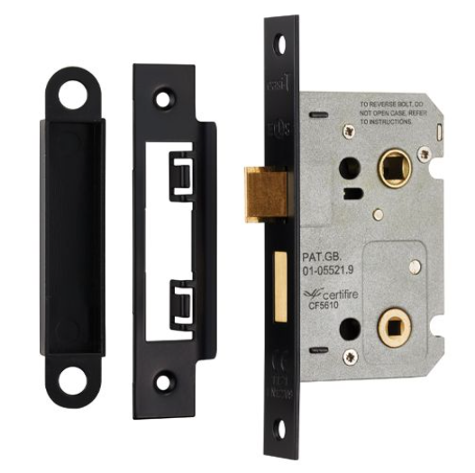

B1 L2 Princess Homes Subd. Novaliches, Quezon City  urbanity2022@gmail.com  927 361 2713
B1 L2 Princess Homes Subd. Novaliches, Quezon City  urbanity2022@gmail.com  927 361 2713
BAE5025MB
EUROSPEC™ EASI-T BATHROOM LOCK - RESIDENTIAL
Contract Bathroom Lock with a wide range of options offering an excellent degree of choice. The Latch bolt has the Easi-T reverse function to save undoing the case so it can be reversed in seconds. This lock carries a 10-year mechanical guarantee. It has been CE tested and is Fire Door Rated. Suitable for use in all domestic, industrial and commercial environments. Available in different finishes and sizes. Square and Radius options.

Slide 24
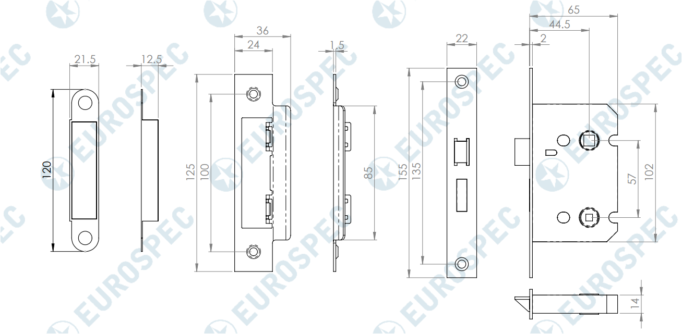


B1 L2 Princess Homes Subd. Novaliches, Quezon City  urbanity2022@gmail.com  927 361 2713
B1 L2 Princess Homes Subd. Novaliches, Quezon City  urbanity2022@gmail.com  927 361 2713
ITEM CODE | BAE5025
MANUFACTURER | CARLISLE BRASS LTD UK
BRAND | EUROSPEC
AVAILABLE FINISH | MATT BLACK
TYPE | BATHROOM LOCK
MECHANICAL WARRANTY | 10 YEARS

Slide 25
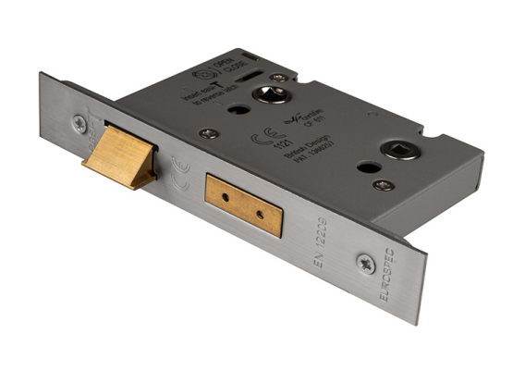

B1 L2 Princess Homes Subd. Novaliches, Quezon City  urbanity2022@gmail.com  927 361 2713
B1 L2 Princess Homes Subd. Novaliches, Quezon City  urbanity2022@gmail.com  927 361 2713
BAS5025
EUROSPEC™ EASI-T BATHROOM LOCK - ARCHITECTURAL
Bathroom Lock in 64mm. The Latch bolt has the Easi-T reverse function to save undoing the case so it can be reversed in seconds. Certified to BS EN 12209. This lock provides a good degree of security and carries a 10 year mechanical guarantee. It has been CE and Certifire tested. Suitable for use in all domestic, industrial and commercial environments.

Slide 26
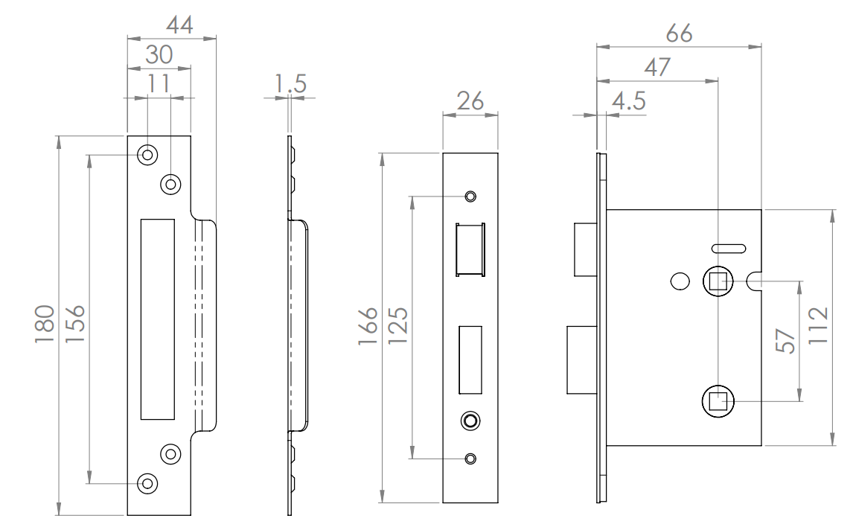

B1 L2 Princess Homes Subd. Novaliches, Quezon City  urbanity2022@gmail.com  927 361 2713
B1 L2 Princess Homes Subd. Novaliches, Quezon City  urbanity2022@gmail.com  927 361 2713
ITEM CODE | BAS5025
MANUFACTURER | CARLISLE BRASS LTD UK
BRAND | EUROSPEC
AVAILABLE FINISH | MATT BLACK SATIN BRASS ANTIQUE BRASS SATIN STAINLESS STEEL
TYPE | BATHROOM LOCK
MECHANICAL WARRANTY | 10 YEARS

Slide 27
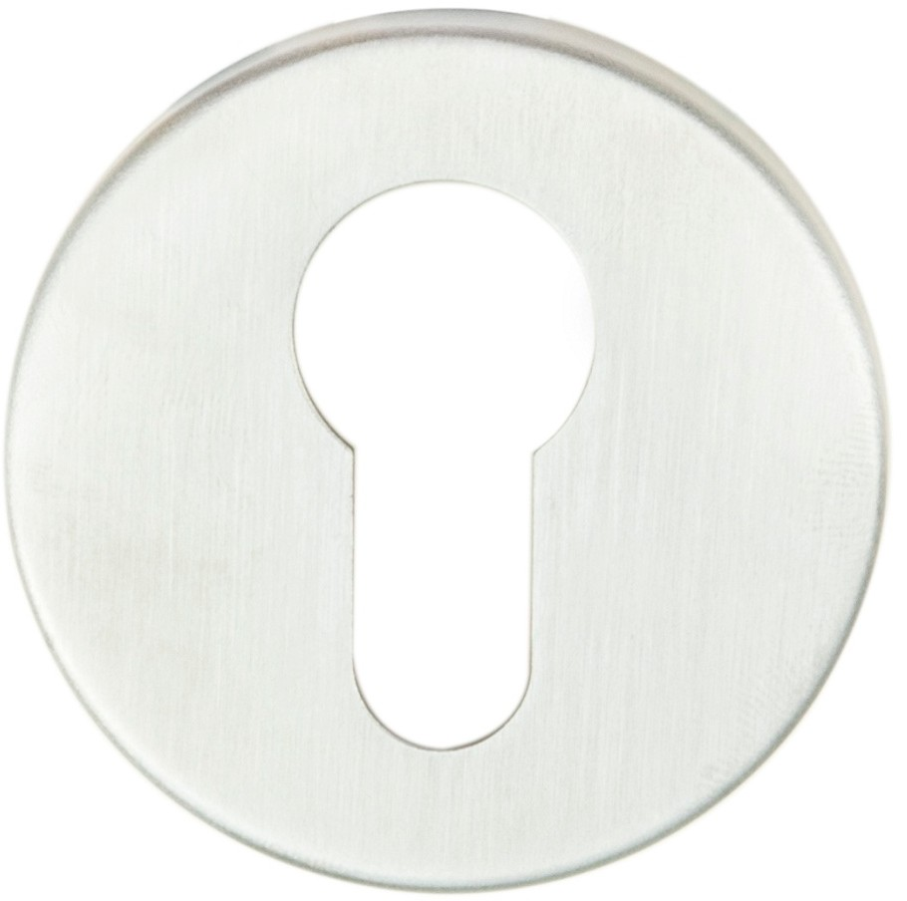

B1 L2 Princess Homes Subd. Novaliches, Quezon City  urbanity2022@gmail.com  927 361 2713
B1 L2 Princess Homes Subd. Novaliches, Quezon City  urbanity2022@gmail.com  927 361 2713
CSE1005SSS
EUROSPEC™ EUROPROFILE ESCUTCHEON – SATIN STAINLESS STEEL
Europrofile Escutcheon on concealed fix press on rose to all of the Steelworx levers. Part of the Steelwork range in Grade 304 Stainless Steel. Fire Door Rated.

Slide 28
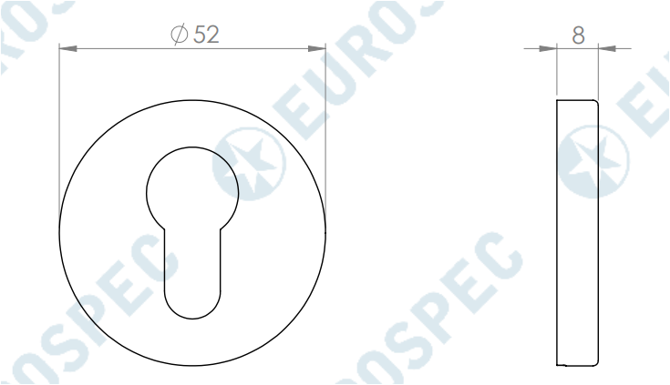
B1 L2 Princess Homes Subd. Novaliches, Quezon City  urbanity2022@gmail.com  927 361 2713
B1 L2 Princess Homes Subd. Novaliches, Quezon City  urbanity2022@gmail.com  927 361 2713
ITEM CODE | CSE1005
MANUFACTURER | CARLISLE BRASS LTD UK
BRAND | EUROSPEC
AVAILABLE FINISH | SATIN STAINLESS STEEL
TYPE | ESCUTCHEON
DIAMETER | 52MM
PROJECTION | 8MM
MECHANICAL WARRANTY | 10 YEARS

Slide 29
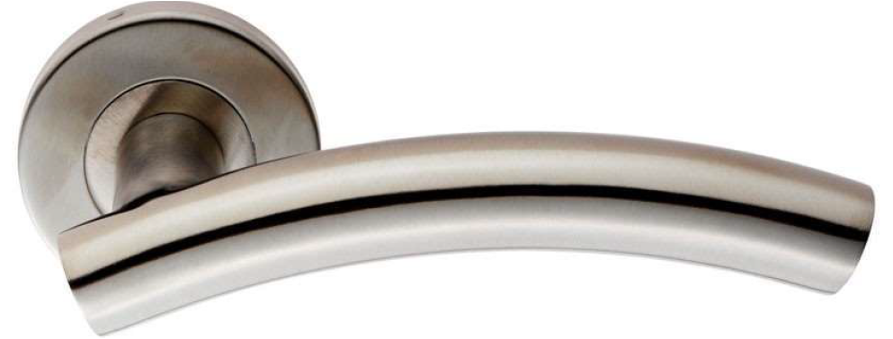

B1 L2 Princess Homes Subd. Novaliches, Quezon City  urbanity2022@gmail.com  927 361 2713
B1 L2 Princess Homes Subd. Novaliches, Quezon City  urbanity2022@gmail.com  927 361 2713
CSL1193SSS
EUROSPEC™ CURVED LEVER HANDLE ON ROSE
Lever on concealed fix press on round rose. Curved round bar lever (19mm) with a slightly higher than standard arch making it very ergonomic. Comes with a 10 year mechanical guarantee and is Fire Door Rated. Suitable for domestic and commercial use.

Slide 30
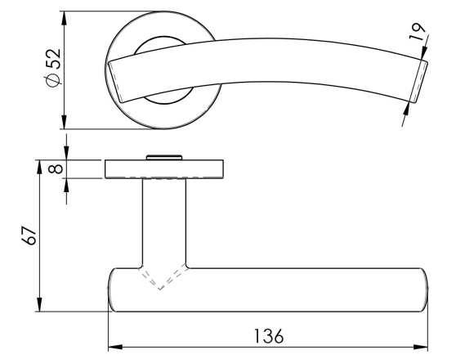

B1 L2 Princess Homes Subd. Novaliches, Quezon City  urbanity2022@gmail.com  927 361 2713
B1 L2 Princess Homes Subd. Novaliches, Quezon City  urbanity2022@gmail.com  927 361 2713
ITEM CODE | CSL1193
MANUFACTURER | CARLISLE BRASS LTD UK
BRAND | EUROSPEC
AVAILABLE FINISH | SATIN STAINLESS STEEL
TYPE | LEVER HANDLE
DIAMETER | ROSE: 52MM BAR : 19MM
PROJECTION | 67MM
LENGTH | 136MM
MECHANICAL WARRANTY | 10 YEARS

Slide 31
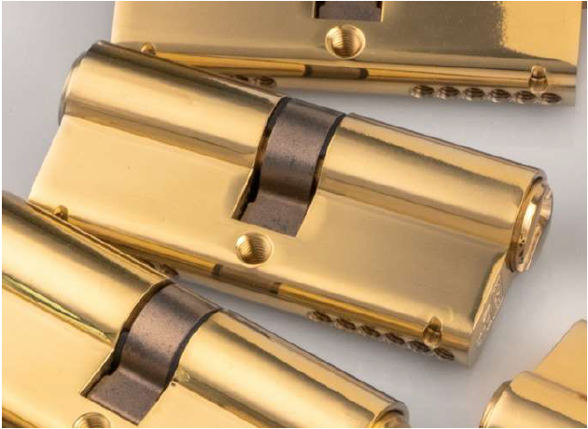
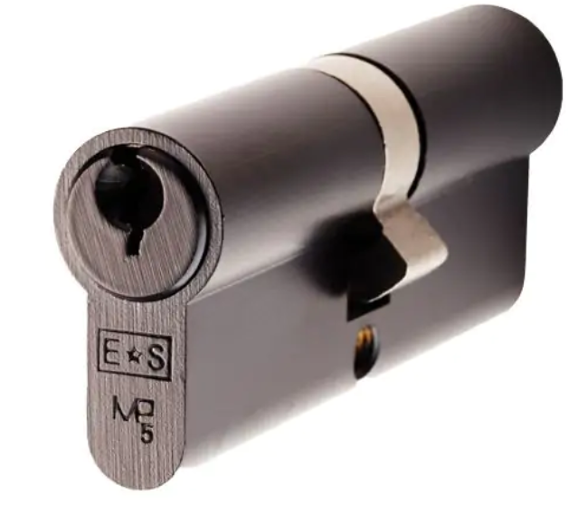
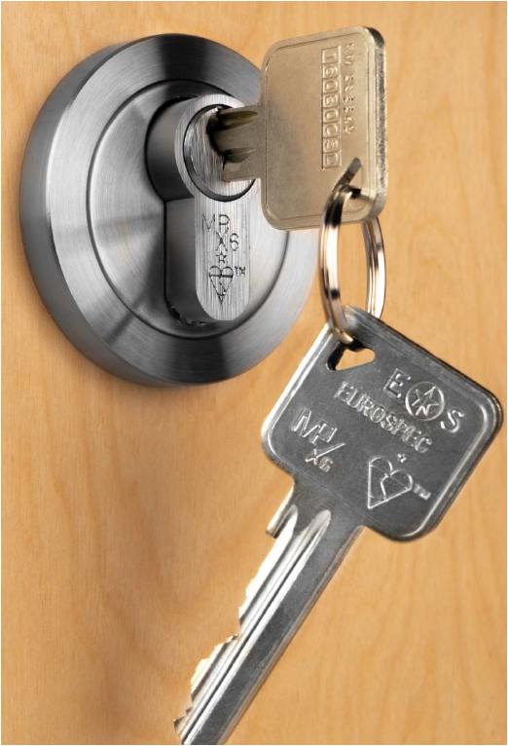


B1 L2 Princess Homes Subd. Novaliches, Quezon City  urbanity2022@gmail.com  927 361 2713
B1 L2 Princess Homes Subd. Novaliches, Quezon City  urbanity2022@gmail.com  927 361 2713
CYA71270
EUROSPEC™ 70MM EUROPROFILE DOUBLE CYLINDER
Euro Double Cylinder. These MP5 Architectural 5 pin cylinders provide a good degree of security. Fire Door rated. Keyed alike or master keyed options available. Comes with a 5 year mechanical guarantee. Suitable for domestic and commercial use.

Slide 32
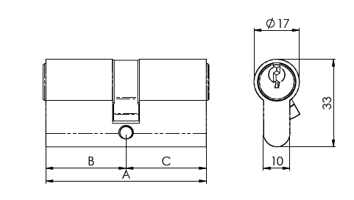

B1 L2 Princess Homes Subd. Novaliches, Quezon City  urbanity2022@gmail.com  927 361 2713
B1 L2 Princess Homes Subd. Novaliches, Quezon City  urbanity2022@gmail.com  927 361 2713
ITEM CODE | CYA71270
MANUFACTURER | CARLISLE BRASS LTD UK
BRAND | EUROSPEC
AVAILABLE FINISH | SATIN CHROME MATT BLACK SATIN BRASS
TYPE | EUROPROFILE CYLINDER
LENGTH | 70MM
MECHANICAL WARRANTY | 5YEARS

Slide 33
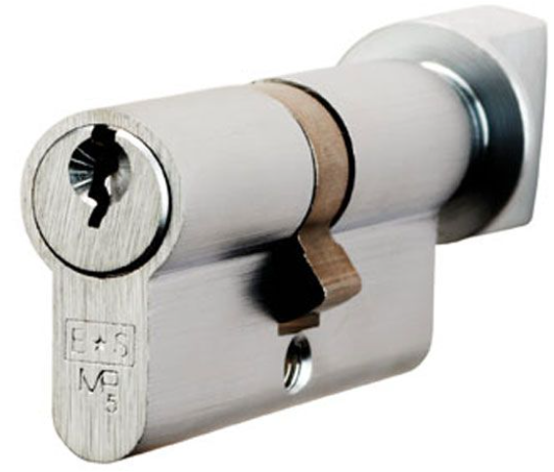

B1 L2 Princess Homes Subd. Novaliches, Quezon City  urbanity2022@gmail.com  927 361 2713
B1 L2 Princess Homes Subd. Novaliches, Quezon City  urbanity2022@gmail.com  927 361 2713
CYA71370
EUROSPEC™ 70MM EUROPROFILE CYLINDER & TURN
Euro Cylinder and Turn. To lock the door on the inside, simply use the turn knob, there's no need for a key. These MP5 Architectural 5 pin cylinders provide a good degree of security. Fire Door rated. Keyed alike or master keyed options available. Comes with a 5 year mechanical guarantee. Suitable for domestic and commercial use.

Slide 34
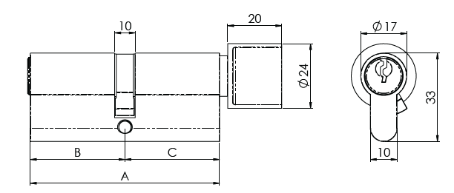
B1 L2 Princess Homes Subd. Novaliches, Quezon City  urbanity2022@gmail.com  927 361 2713
B1 L2 Princess Homes Subd. Novaliches, Quezon City  urbanity2022@gmail.com  927 361 2713
ITEM CODE | CYA71370
MANUFACTURER | CARLISLE BRASS LTD UK
BRAND | EUROSPEC
AVAILABLE FINISH | SATIN CHROME
TYPE | EUROPROFILE CYLINDER
LENGTH | 70MM
MECHANICAL WARRANTY | 5YEARS

Slide 35
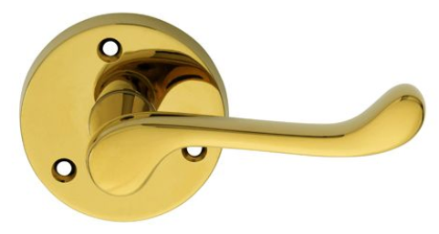

B1 L2 Princess Homes Subd. Novaliches, Quezon City  urbanity2022@gmail.com  927 361 2713
B1 L2 Princess Homes Subd. Novaliches, Quezon City  urbanity2022@gmail.com  927 361 2713
DL56
Carlisle brass™ VICTORIAN SCROLL LEVER ON ROUND ROSE
A traditional Victorian styled scroll lever handle on a round rose. The upturned handle offers a comfortable grip and solid feel as well as long lasting use. A plain and simple minimalist style suitable for home or office. The three point fixing provides secure and easy installation. Comes with a 10 year mechanical guarantee and is Fire door rated. Suitable for domestic and commercial use.

Slide 36
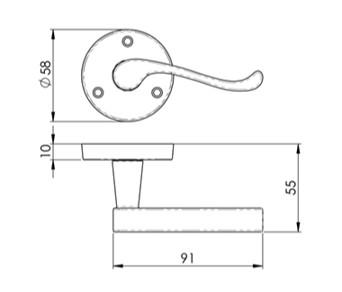
B1 L2 Princess Homes Subd. Novaliches, Quezon City  urbanity2022@gmail.com  927 361 2713
B1 L2 Princess Homes Subd. Novaliches, Quezon City  urbanity2022@gmail.com  927 361 2713
ITEM CODE | DL56
MANUFACTURER | CARLISLE BRASS LTD UK
BRAND | CARLISLE BRASS
AVAILABLE FINISH | POLISH BRASS
TYPE | LEVER HANDLE
ROSSETTE DIAMETER | 58MM
PROJECTION | 55MM
MECHANICAL WARRANTY | 5YEARS

Slide 37
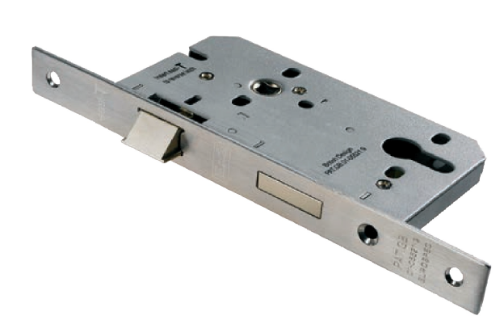
B1 L2 Princess Homes Subd. Novaliches, Quezon City  urbanity2022@gmail.com  927 361 2713
B1 L2 Princess Homes Subd. Novaliches, Quezon City  urbanity2022@gmail.com  927 361 2713
DLE0055EPSSS
EUROSPEC™ DIN STANDARD EUROPROFILE MORTISE sashlock
contract range
Contract Din Euro Profile Sashlock, 55mm. Square or Radius option. The Latch bolt has the Easi-T reverse function to save undoing the case so it can be reversed in seconds. Certified to BS EN 12209. This lock carries a 5 year mechanical guarantee. CE and Certifire tested. Suitable for use in all domestic, industrial and commercial environments.

Slide 38
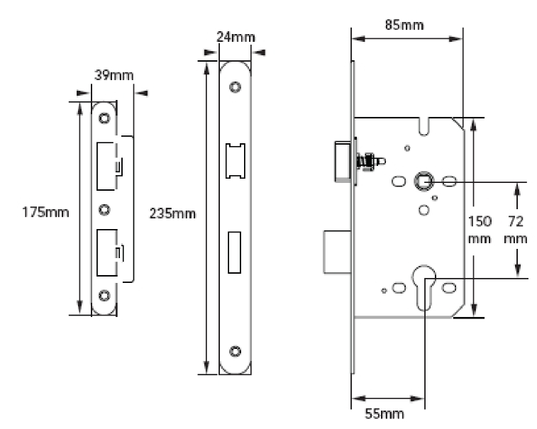

B1 L2 Princess Homes Subd. Novaliches, Quezon City  urbanity2022@gmail.com  927 361 2713
B1 L2 Princess Homes Subd. Novaliches, Quezon City  urbanity2022@gmail.com  927 361 2713
ITEM CODE | DLE7255EPSSS
MANUFACTURER | CARLISLE BRASS LTD UK
BRAND | EUROSPEC
AVAILABLE FINISH | SATIN STAINLESS STEEL
TYPE | MORTISE LOCK
BACKSET | 55MM
CENTRES | 72MM
MECHANICAL WARRANTY | 5 YEARS

Slide 39
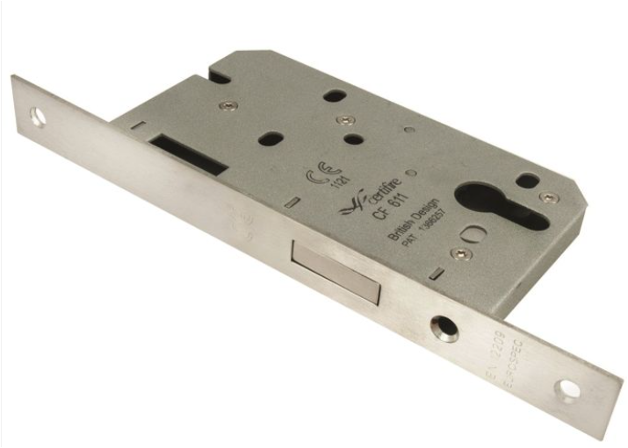
B1 L2 Princess Homes Subd. Novaliches, Quezon City  urbanity2022@gmail.com  927 361 2713
B1 L2 Princess Homes Subd. Novaliches, Quezon City  urbanity2022@gmail.com  927 361 2713
DLE0055EPSSS
EUROSPEC™ DIN STANDARD EUROPROFILE MORTISE DEADLOCK
contract range
Contract Din Euro Profile Deadlock, Square or Radius options. Certified to BS EN 12209. Used as a matter of course by the national house builders. This lock carries a 5 year mechanical guarantee. It has been CE and Certifire tested. Suitable for use in all domestic, industrial and commercial environments.

Slide 40
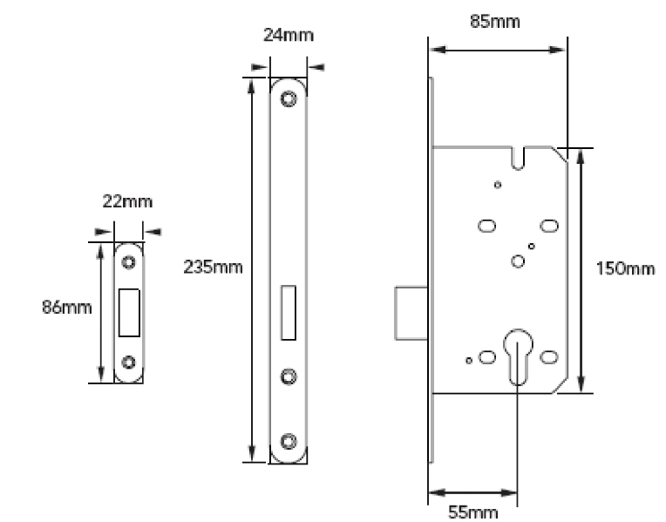
B1 L2 Princess Homes Subd. Novaliches, Quezon City  urbanity2022@gmail.com  927 361 2713
B1 L2 Princess Homes Subd. Novaliches, Quezon City  urbanity2022@gmail.com  927 361 2713
ITEM CODE | DLE0055EPSSS
MANUFACTURER | CARLISLE BRASS LTD UK
BRAND | EUROSPEC
AVAILABLE FINISH | SATIN STAINLESS STEEL
TYPE | MORTISE LOCK
BACKSET | 55MM
OVERALL LENGTH (FACEPLATE) | 235MM
MECHANICAL WARRANTY | 5 YEARS

Slide 41
B1 L2 Princess Homes Subd. Novaliches, Quezon City  urbanity2022@gmail.com  927 361 2713
B1 L2 Princess Homes Subd. Novaliches, Quezon City  urbanity2022@gmail.com  927 361 2713
DLE0055EPSSS
EUROSPEC™ DIN STANDARD MORTISE bathroom
contract range
Contract Din Euro Profile Deadlock, Square or Radius options. Certified to BS EN 12209. Used as a matter of course by the national house builders. This lock carries a 5 year mechanical guarantee. It has been CE and Certifire tested. Suitable for use in all domestic, industrial and commercial environments.

Slide 42
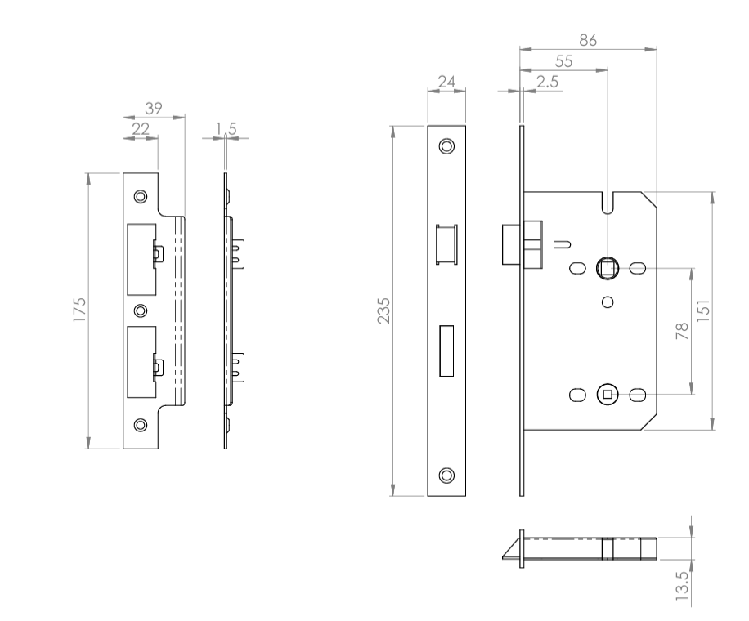
B1 L2 Princess Homes Subd. Novaliches, Quezon City  urbanity2022@gmail.com  927 361 2713
B1 L2 Princess Homes Subd. Novaliches, Quezon City  urbanity2022@gmail.com  927 361 2713
ITEM CODE | DLE7855WCSSS
MANUFACTURER | CARLISLE BRASS LTD UK
BRAND | EUROSPEC
AVAILABLE FINISH | SATIN STAINLESS STEEL
TYPE | MORTISE LOCK
BACKSET | 55MM
CENTRES | 78MM
MECHANICAL WARRANTY | 5 YEARS

Slide 43
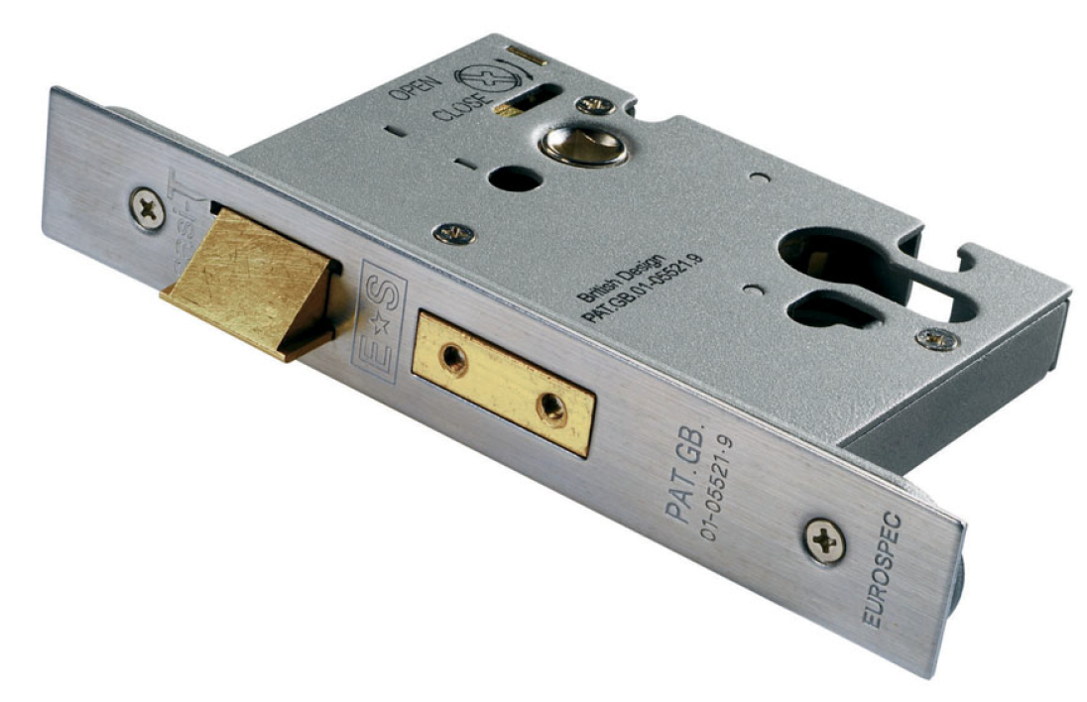

B1 L2 Princess Homes Subd. Novaliches, Quezon City  urbanity2022@gmail.com  927 361 2713
B1 L2 Princess Homes Subd. Novaliches, Quezon City  urbanity2022@gmail.com  927 361 2713
ESS5025
EUROSPEC™ DIN STANDARD EUROPROFILE MORTISE SASHLOCK
ARCHITECTURAL RANGE
Euro Profile Sashlock in 64mM. The Latchbolt has the Easi-T reverse function to save undoing the case so it can be reversed in seconds. Certified to BS EN 12209. This lock provides a good degree of security and carries a 10 year mechanical guarantee. It has been CE and Certifire tested. Suitable for use in all domestic, industrial and commercial environments.

Slide 44
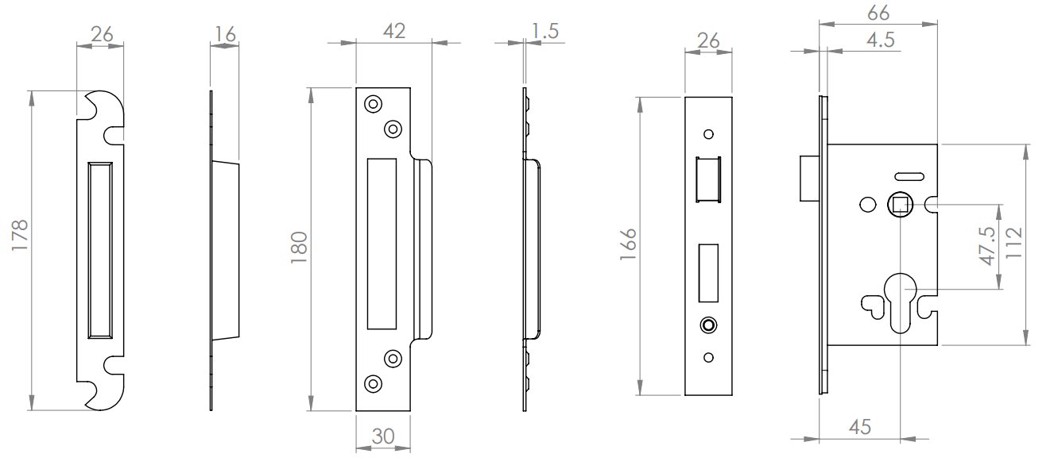

B1 L2 Princess Homes Subd. Novaliches, Quezon City  urbanity2022@gmail.com  927 361 2713
B1 L2 Princess Homes Subd. Novaliches, Quezon City  urbanity2022@gmail.com  927 361 2713
ITEM CODE | ESS5025
MANUFACTURER | CARLISLE BRASS LTD UK
BRAND | EUROSPEC
AVAILABLE FINISH | SATIN STAINLESS STEEL ANTIQUE BRASS SATIN BRASS MATT BLACK
TYPE | MORTISE LOCK
BACKSET | 45MM
CENTRES | 47.5MM
MECHANICAL WARRANTY | 10 YEARS

Slide 45
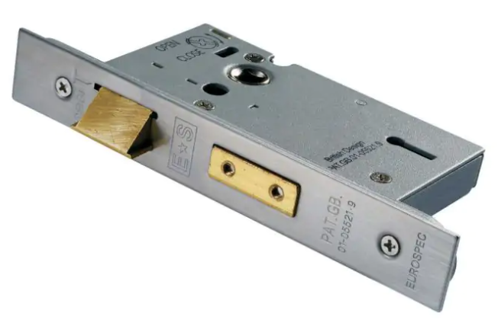

B1 L2 Princess Homes Subd. Novaliches, Quezon City  urbanity2022@gmail.com  927 361 2713
B1 L2 Princess Homes Subd. Novaliches, Quezon City  urbanity2022@gmail.com  927 361 2713
LSS5325
EUROSPEC™ EASI-T 3 LEVER SASHLOCK
ARCHITECTURAL RANGE
3 Lever Sashlock Square Forend 64mm. The Latchbolt has the Easi-T reverse function to save undoing the case so it can be reversed in seconds. British Standard BS EN 12209 Rated LocK. This lock provides a good degree of security and carries a 10 year mechanical guarantee. CE and Certifire tested. Suitable for use in all domestic, industrial and commercial environments.

Slide 46
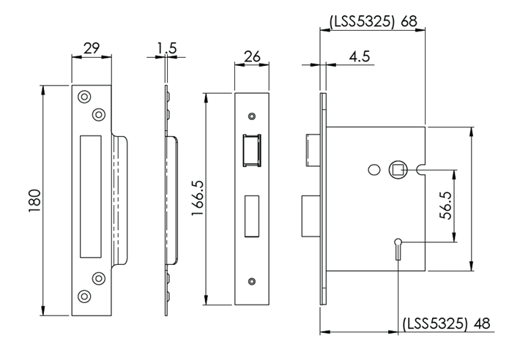


B1 L2 Princess Homes Subd. Novaliches, Quezon City  urbanity2022@gmail.com  927 361 2713
B1 L2 Princess Homes Subd. Novaliches, Quezon City  urbanity2022@gmail.com  927 361 2713
ITEM CODE | LSS5325
MANUFACTURER | CARLISLE BRASS LTD UK
BRAND | EUROSPEC
AVAILABLE FINISH | SATIN STAINLESS STEEL ANTIQUE BRASS SATIN BRASS MATT BLACK
TYPE | MORTISE LOCK
BACKSET | 48MM
CENTRES | 56.5MM
MECHANICAL WARRANTY | 10 YEARS

Slide 47
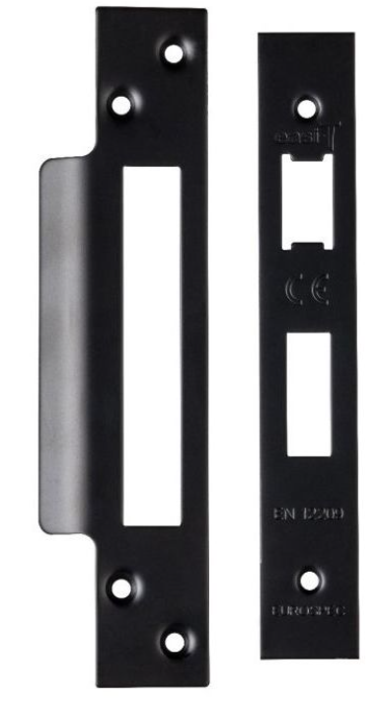
B1 L2 Princess Homes Subd. Novaliches, Quezon City  urbanity2022@gmail.com  927 361 2713
B1 L2 Princess Homes Subd. Novaliches, Quezon City  urbanity2022@gmail.com  927 361 2713
FSF5004
EUROSPEC™ FOREND STRIKE & FIXING PACK
MATT BLACK

Slide 48

B1 L2 Princess Homes Subd. Novaliches, Quezon City  urbanity2022@gmail.com  927 361 2713
B1 L2 Princess Homes Subd. Novaliches, Quezon City  urbanity2022@gmail.com  927 361 2713
FSF5004
EUROSPEC™ FOREND STRIKE & FIXING PACK
SATIN BRASS

Slide 49

B1 L2 Princess Homes Subd. Novaliches, Quezon City  urbanity2022@gmail.com  927 361 2713
B1 L2 Princess Homes Subd. Novaliches, Quezon City  urbanity2022@gmail.com  927 361 2713
FSF5004
EUROSPEC™ FOREND STRIKE & FIXING PACK
ANTIQUE BRASS

Slide 50

B1 L2 Princess Homes Subd. Novaliches, Quezon City  urbanity2022@gmail.com  927 361 2713
B1 L2 Princess Homes Subd. Novaliches, Quezon City  urbanity2022@gmail.com  927 361 2713
ITEM CODE | FSF5004
MANUFACTURER | CARLISLE BRASS LTD UK
BRAND | EUROSPEC
AVAILABLE FINISH | ANTIQUE BRASS SATIN BRASS MATT BLACK
TYPE | ACCESSORIES
MECHANICAL WARRANTY | 5 YEARS

Slide 51




B1 L2 Princess Homes Subd. Novaliches, Quezon City  urbanity2022@gmail.com  927 361 2713
B1 L2 Princess Homes Subd. Novaliches, Quezon City  urbanity2022@gmail.com  927 361 2713
EUL001
Carlisle brass™ euro profile escutcheon
Euro profile escutcheon on a concealed fix screw on rose. Designed to match the new finishes collection range of designer handles on round roses.

Slide 52


B1 L2 Princess Homes Subd. Novaliches, Quezon City  urbanity2022@gmail.com  927 361 2713
B1 L2 Princess Homes Subd. Novaliches, Quezon City  urbanity2022@gmail.com  927 361 2713
ITEM CODE | EUL001
MANUFACTURER | CARLISLE BRASS LTD UK
BRAND | CARLISLE BRASS
AVAILABLE FINISH | ANTIQUE BRASS SATIN BRASS MATT BLACK
TYPE | ESCUTCHEON
DIAMETER | 50MM
DEPTH | 10MM
MECHANICAL WARRANTY | 25 YEARS

Slide 53



B1 L2 Princess Homes Subd. Novaliches, Quezon City  urbanity2022@gmail.com  927 361 2713
B1 L2 Princess Homes Subd. Novaliches, Quezon City  urbanity2022@gmail.com  927 361 2713
EUL004
Carlisle brass™ BATHROOM THUMBTURN AND RELEASE
Thumbturn and release on a screw on rose, concealed fix. Designed to match the new finishes collection range of designer handles on round roses.

Slide 54


B1 L2 Princess Homes Subd. Novaliches, Quezon City  urbanity2022@gmail.com  927 361 2713
B1 L2 Princess Homes Subd. Novaliches, Quezon City  urbanity2022@gmail.com  927 361 2713
ITEM CODE | EUL004
MANUFACTURER | CARLISLE BRASS LTD UK
BRAND | CARLISLE BRASS
AVAILABLE FINISH | ANTIQUE BRASS SATIN BRASS MATT BLACK
TYPE | TURN AND RELEASE
DIAMETER | 50MM
PROJECTION | 36MM
MECHANICAL WARRANTY | 25 YEARS

Slide 55




B1 L2 Princess Homes Subd. Novaliches, Quezon City  urbanity2022@gmail.com  927 361 2713
B1 L2 Princess Homes Subd. Novaliches, Quezon City  urbanity2022@gmail.com  927 361 2713
EUL030
Carlisle brass™ TRENTINO LEVER ON ROUND ROSE
Lever on a concealed fix 2 part screw on round rose. A straight lever simple but elegant, ideal for creating a minimalistic effect. Ergonomic and comfortable to use, ideal for heavy use in the office or school. Comes with a 25 year mechanical guarantee and is Fire door rated. Suitable for domestic and commercial use.

Slide 56

B1 L2 Princess Homes Subd. Novaliches, Quezon City  urbanity2022@gmail.com  927 361 2713
B1 L2 Princess Homes Subd. Novaliches, Quezon City  urbanity2022@gmail.com  927 361 2713
ITEM CODE | EUL030
MANUFACTURER | CARLISLE BRASS LTD UK
BRAND | CARLISLE BRASS
AVAILABLE FINISH | MATT BLACK
TYPE | LEVER HANDLE
DIAMETER | 50MM
PROJECTION | 63MM
MECHANICAL WARRANTY | 25 YEARS

Slide 57




B1 L2 Princess Homes Subd. Novaliches, Quezon City  urbanity2022@gmail.com  927 361 2713
B1 L2 Princess Homes Subd. Novaliches, Quezon City  urbanity2022@gmail.com  927 361 2713
EUL040
Carlisle brass™ AMIATA LEVER ON ROUND ROSE
Lever on a concealed fix 2 part screw on round rose. A stylish round bar lever reflecting the attention to detail in this range. Comes with a 25 year mechanical guarantee and is Fire door rated. Suitable for domestic and commercial use.

Slide 58

B1 L2 Princess Homes Subd. Novaliches, Quezon City  urbanity2022@gmail.com  927 361 2713
B1 L2 Princess Homes Subd. Novaliches, Quezon City  urbanity2022@gmail.com  927 361 2713
ITEM CODE | EUL040
MANUFACTURER | CARLISLE BRASS LTD UK
BRAND | CARLISLE BRASS
AVAILABLE FINISH | SATIN BRASS
TYPE | LEVER HANDLE
DIAMETER | 50MM
PROJECTION | 64MM
MECHANICAL WARRANTY | 25 YEARS

Slide 59




B1 L2 Princess Homes Subd. Novaliches, Quezon City  urbanity2022@gmail.com  927 361 2713
B1 L2 Princess Homes Subd. Novaliches, Quezon City  urbanity2022@gmail.com  927 361 2713
EUL050
Carlisle brass™ VARESE LEVER ON ROUND ROSE
Lever on a concealed fix 2 part screw on round rose. A stylish knurled for grip round bar lever. Comes with a 25 year mechanical guarantee and is Fire door rated. Suitable for domestic and commercial use.

Slide 60

B1 L2 Princess Homes Subd. Novaliches, Quezon City  urbanity2022@gmail.com  927 361 2713
B1 L2 Princess Homes Subd. Novaliches, Quezon City  urbanity2022@gmail.com  927 361 2713
ITEM CODE | EUL050
MANUFACTURER | CARLISLE BRASS LTD UK
BRAND | CARLISLE BRASS
AVAILABLE FINISH | MATT BLACK
TYPE | LEVER HANDLE
DIAMETER | 50MM
PROJECTION | 63MM
MECHANICAL WARRANTY | 25 YEARS

Slide 61



B1 L2 Princess Homes Subd. Novaliches, Quezon City  urbanity2022@gmail.com  927 361 2713
B1 L2 Princess Homes Subd. Novaliches, Quezon City  urbanity2022@gmail.com  927 361 2713
EUL050
Carlisle brass™ VARESE LEVER ON ROUND ROSE
Lever on a concealed fix 2 part screw on round rose. A stylish knurled for grip round bar lever. Comes with a 25 year mechanical guarantee and is Fire door rated. Suitable for domestic and commercial use.

Slide 62
B1 L2 Princess Homes Subd. Novaliches, Quezon City  urbanity2022@gmail.com  927 361 2713
B1 L2 Princess Homes Subd. Novaliches, Quezon City  urbanity2022@gmail.com  927 361 2713
ITEM CODE | EUL050
MANUFACTURER | CARLISLE BRASS LTD UK
BRAND | CARLISLE BRASS
AVAILABLE FINISH | SATIN BRASS
TYPE | LEVER HANDLE
DIAMETER | 50MM
PROJECTION | 63MM
MECHANICAL WARRANTY | 25 YEARS

Slide 63

B1 L2 Princess Homes Subd. Novaliches, Quezon City  urbanity2022@gmail.com  927 361 2713
B1 L2 Princess Homes Subd. Novaliches, Quezon City  urbanity2022@gmail.com  927 361 2713
EUL050
Carlisle brass™ VARESE LEVER ON ROUND ROSE
Lever on a concealed fix 2 part screw on round rose. A stylish knurled for grip round bar lever. Comes with a 25 year mechanical guarantee and is Fire door rated. Suitable for domestic and commercial use.

Slide 64
B1 L2 Princess Homes Subd. Novaliches, Quezon City  urbanity2022@gmail.com  927 361 2713
B1 L2 Princess Homes Subd. Novaliches, Quezon City  urbanity2022@gmail.com  927 361 2713
ITEM CODE | EUL050
MANUFACTURER | CARLISLE BRASS LTD UK
BRAND | CARLISLE BRASS
AVAILABLE FINISH | ANTIQUE BRASS
TYPE | LEVER HANDLE
DIAMETER | 50MM
PROJECTION | 63MM
MECHANICAL WARRANTY | 25 YEARS

Slide 65


B1 L2 Princess Homes Subd. Novaliches, Quezon City  urbanity2022@gmail.com  927 361 2713
B1 L2 Princess Homes Subd. Novaliches, Quezon City  urbanity2022@gmail.com  927 361 2713
FG3
Carlisle brass™ GEORGIAN LEVER ON ROUND ROSE
Georgian lever on a 64mm round rose. Reminiscent of a bygone era the Georgian handle retains the traditional roped pattern adornment. It features a rope design atop the scroll curved lever and along the edging of the rose.

Slide 66


B1 L2 Princess Homes Subd. Novaliches, Quezon City  urbanity2022@gmail.com  927 361 2713
B1 L2 Princess Homes Subd. Novaliches, Quezon City  urbanity2022@gmail.com  927 361 2713
ITEM CODE | FG3
MANUFACTURER | CARLISLE BRASS LTD UK
BRAND | CARLISLE BRASS
AVAILABLE FINISH | POLISHED BRASS
TYPE | LEVER HANDLE
ROSSETTE DIAMETER | 64MM
PROJECTION | 62MM
MECHANICAL WARRANTY | 25 YEARS

Slide 67


B1 L2 Princess Homes Subd. Novaliches, Quezon City  urbanity2022@gmail.com  927 361 2713
B1 L2 Princess Homes Subd. Novaliches, Quezon City  urbanity2022@gmail.com  927 361 2713
FTD1044
Ludlow ™ RING PULL ON GOTHIC CROSS BACKPLATE
Ring pull sitting resplendent on a gothic cross backplate. Best suited for older style antique furniture. Designed to compliment the furniture in the Ludlow Black Antique range. Comes with a 10 year mechanical guarantee. Suitable for domestic and commercial use.

Slide 68


B1 L2 Princess Homes Subd. Novaliches, Quezon City  urbanity2022@gmail.com  927 361 2713
B1 L2 Princess Homes Subd. Novaliches, Quezon City  urbanity2022@gmail.com  927 361 2713
ITEM CODE | FTD1044
MANUFACTURER | CARLISLE BRASS LTD UK
BRAND | LUDLOW
AVAILABLE FINISH | BLACK ANTIQUE
TYPE | CABINET HANDLE
MECHANICAL WARRANTY | 10 YEARS

Slide 69

B1 L2 Princess Homes Subd. Novaliches, Quezon City  urbanity2022@gmail.com  927 361 2713
B1 L2 Princess Homes Subd. Novaliches, Quezon City  urbanity2022@gmail.com  927 361 2713
DCT2024SV
EUROSPEC™ OVERHEAD DOOR CLOSER
Overhead Door Closer Variable Power Size 2-4. Certified to BS EN1154. CE marked and Certifire tested. Comes with a 10 year mechanical guarantee and is Fire door rated. Suitable for domestic and commercial use. Suitable for left and right hand application. Suitable for fire door use and steel fire door use. Suitable for doors up to 80kg and/or 1100mm wide. Simple power size adjustment with supplied key.

Slide 70


B1 L2 Princess Homes Subd. Novaliches, Quezon City  urbanity2022@gmail.com  927 361 2713
B1 L2 Princess Homes Subd. Novaliches, Quezon City  urbanity2022@gmail.com  927 361 2713
ITEM CODE | DCT2024SV
MANUFACTURER | CARLISLE BRASS LTD UK
BRAND | EUROSPEC
AVAILABLE FINISH | SILVER
TYPE | DOOR CLOSER
MAXIMUM DOOR WIDTH | 1100MM
MAXIMUM DOOR WEIGHT | 80 KGS
ANGLE OPENING | 180°
MECHANICAL WARRANTY | 10 YEARS

Slide 71

B1 L2 Princess Homes Subd. Novaliches, Quezon City  urbanity2022@gmail.com  927 361 2713
B1 L2 Princess Homes Subd. Novaliches, Quezon City  urbanity2022@gmail.com  927 361 2713
CDG003
EUROSPEC™ OVERHEAD POWER SIZE 3 DOOR CLOSER
This Contract overhead door closer is a fixed power size 3 closer suitable for doors up to 950mm wide weighting no more than 60Kg. Angle of opening is 180 degrees. An all round door closer to suit all domestic and light office applications. It has a CE mark and is BS EN 1154 approved. Suitable for domestic and commercial use and is fire door rated.

Slide 72


B1 L2 Princess Homes Subd. Novaliches, Quezon City  urbanity2022@gmail.com  927 361 2713
B1 L2 Princess Homes Subd. Novaliches, Quezon City  urbanity2022@gmail.com  927 361 2713
ITEM CODE | CDG003
MANUFACTURER | CARLISLE BRASS LTD UK
BRAND | EUROSPEC
AVAILABLE FINISH | SILVER
TYPE | DOOR CLOSER
MAXIMUM DOOR WIDTH | 950MM
MAXIMUM DOOR WEIGHT | 60 KGS
ANGLE OPENING | 180°
MECHANICAL WARRANTY | 5 YEARS

Slide 73

B1 L2 Princess Homes Subd. Novaliches, Quezon City  urbanity2022@gmail.com  927 361 2713
B1 L2 Princess Homes Subd. Novaliches, Quezon City  urbanity2022@gmail.com  927 361 2713
SSL1401MB
EUROSPEC™ ALVAR DESIGNER LEVER ON SPRUNG SQUARE ROSE
A square cut straight bar lever on a concealed fix square press on rose. An unfussy design which will blend well in a variety of applications. Part of a square themed designer lever collection in the Steelworx range in grade 304 Stainless Steel. Comes with a 10-year mechanical guarantee. Suitable for domestic and commercial use. Matching escutcheons, turn and release available.

Slide 74


B1 L2 Princess Homes Subd. Novaliches, Quezon City  urbanity2022@gmail.com  927 361 2713
B1 L2 Princess Homes Subd. Novaliches, Quezon City  urbanity2022@gmail.com  927 361 2713
ITEM CODE | SSL1401MB
MANUFACTURER | CARLISLE BRASS LTD UK
BRAND | EUROSPEC
AVAILABLE FINISH | MATT BLACK
TYPE | LEVER HANDLE
ROSSETTE DIMENSION | 52MM x 52MM
ROSSETTE DEPTH | 8MM
PROJECTION | 128MM
MECHANICAL WARRANTY | 10 YEARS

Slide 75

B1 L2 Princess Homes Subd. Novaliches, Quezon City  urbanity2022@gmail.com  927 361 2713
B1 L2 Princess Homes Subd. Novaliches, Quezon City  urbanity2022@gmail.com  927 361 2713
SST1415MB
EUROSPEC™ SQUARE THUMBTURN AND RELEASE WITH INDICATOR
Square Thumbturn and Release with indicator on a concealed fix press on square rose. Matches all the square themed designer lever handles in the SSL range. Fire door rated. Suitable for domestic and commercial use.

Slide 76



B1 L2 Princess Homes Subd. Novaliches, Quezon City  urbanity2022@gmail.com  927 361 2713
B1 L2 Princess Homes Subd. Novaliches, Quezon City  urbanity2022@gmail.com  927 361 2713
ITEM CODE | SST1415MB
MANUFACTURER | CARLISLE BRASS LTD UK
BRAND | EUROSPEC
AVAILABLE FINISH | MATT BLACK
TYPE | TURN AND RELEASE
ROSSETTE DIMENSION | 52MM x 52MM
ROSSETTE DEPTH | 8MM
MECHANICAL WARRANTY | 10 YEARS

Slide 77

B1 L2 Princess Homes Subd. Novaliches, Quezon City  urbanity2022@gmail.com  927 361 2713
B1 L2 Princess Homes Subd. Novaliches, Quezon City  urbanity2022@gmail.com  927 361 2713
SSE1405MB
EUROSPEC™ SQUARE EUROPROFILE ESCUTCHEON
Euro Profile two part concealed fix square escutcheon. Matches all the square themed designer lever handles in the SSL range. Fire door rated. Suitable for domestic and commercial use. Available in Matt Black Finish

Slide 78

B1 L2 Princess Homes Subd. Novaliches, Quezon City  urbanity2022@gmail.com  927 361 2713
B1 L2 Princess Homes Subd. Novaliches, Quezon City  urbanity2022@gmail.com  927 361 2713
ITEM CODE | SST1415MB
MANUFACTURER | CARLISLE BRASS LTD UK
BRAND | EUROSPEC
AVAILABLE FINISH | MATT BLACK
TYPE | EUROPROFILE
ROSSETTE DIMENSION | 52MM x 52MM
ROSSETTE DEPTH | 8MM
MECHANICAL WARRANTY | 10 YEARS

Slide 79

B1 L2 Princess Homes Subd. Novaliches, Quezon City  urbanity2022@gmail.com  927 361 2713
B1 L2 Princess Homes Subd. Novaliches, Quezon City  urbanity2022@gmail.com  927 361 2713
CST1025iSSS
EUROSPEC™ DISABLE THUMBTURN AND RELEASE WITH INDICATOR
Thumbturn and Release on a concealed fix press on rose. The turn side has a long straight tubular bar, and the release side has a vacant/engaged indicator. To meet the needs of Disabled people. Ideal for public/office toilet doors where a more ergonomic operation is a necessary requirement. Comes with a 10 year mechanical guarantee and is Fire door rated. Suitable for all domestic, commercial and industrial use.

Slide 80


B1 L2 Princess Homes Subd. Novaliches, Quezon City  urbanity2022@gmail.com  927 361 2713
B1 L2 Princess Homes Subd. Novaliches, Quezon City  urbanity2022@gmail.com  927 361 2713
ITEM CODE | CST1025iSSS
MANUFACTURER | CARLISLE BRASS LTD UK
BRAND | EUROSPEC
AVAILABLE FINISH | SATIN STAINLESS STEEL
TYPE | TURN AND RELEASE
ROSSETTE DIMENSION | 52MM x 52MM
ROSSETTE DEPTH | 8MM
PROJECTION | 38MM
MECHANICAL WARRANTY | 10 YEARS

Slide 81

B1 L2 Princess Homes Subd. Novaliches, Quezon City  urbanity2022@gmail.com  927 361 2713
B1 L2 Princess Homes Subd. Novaliches, Quezon City  urbanity2022@gmail.com  927 361 2713
CST1015iSSS
EUROSPEC™ THUMBTURN AND RELEASE WITH INDICATOR
Standard Turn and Release with a vacant/engaged Indicator. Concealed fix press on rose. Stylish bathroom turn and release, thumb turn on one side and an emergency release slot on the other. Part of the Steelwork range in Grade 304 Stainless Steel and will match all of the Steelworx levers. Contemporary design will suit domestic and commercially orientated environments. Comes with a 10 year mechanical guarantee and is Fire Door Rated.

Slide 82

B1 L2 Princess Homes Subd. Novaliches, Quezon City  urbanity2022@gmail.com  927 361 2713
B1 L2 Princess Homes Subd. Novaliches, Quezon City  urbanity2022@gmail.com  927 361 2713
ITEM CODE | CST1025iSSS
MANUFACTURER | CARLISLE BRASS LTD UK
BRAND | EUROSPEC
AVAILABLE FINISH | SATIN STAINLESS STEEL
TYPE | TURN AND RELEASE
ROSSETTE DIMENSION | 52MM x 52MM
ROSSETTE DEPTH | 8MM
PROJECTION | 38MM
MECHANICAL WARRANTY | 10 YEARS

Slide 83

B1 L2 Princess Homes Subd. Novaliches, Quezon City  urbanity2022@gmail.com  927 361 2713
B1 L2 Princess Homes Subd. Novaliches, Quezon City  urbanity2022@gmail.com  927 361 2713
LF5103
LUDLOW™ ARMORIAL PULL HANDLE ON BACKPLATE
Black Antique traditional style pull handle on backplate which will make a bold and striking addition to any entrance door. The straight armorial handle with pike finials sits on a gothic backplate in which the castle rampant design encompasses the fixing points. This sturdy handle will withstand the rigours of a busy environment such as pubs. Comes with a 10 year mechanical guarantee. Ludlow Black Antique is a traditional range of furniture with a powder coated Black finish.

Slide 84

B1 L2 Princess Homes Subd. Novaliches, Quezon City  urbanity2022@gmail.com  927 361 2713
B1 L2 Princess Homes Subd. Novaliches, Quezon City  urbanity2022@gmail.com  927 361 2713
ITEM CODE
MANUFACTURER | CARLISLE BRASS LTD UK
BRAND | LUDLOW
AVAILABLE FINISH | POWDER COATED BLACK
TYPE | PULL HANDLE
LENGTH | 407MM
PROJECTION | 78MM
MECHANICAL WARRANTY | 10 YEARS

Slide 85

B1 L2 Princess Homes Subd. Novaliches, Quezon City  urbanity2022@gmail.com  927 361 2713
B1 L2 Princess Homes Subd. Novaliches, Quezon City  urbanity2022@gmail.com  927 361 2713
LF5101
LUDLOW™ BARLEY TWIST PULL HANDLE ON BACKPLATE
Black Antique traditional style pull handle on backplate which will make a bold and striking addition to any entrance door. Fleur-de-lys patterns adorn the backplate above and below the twisted handle while the castle rampant design encompasses the fixing points. This sturdy handle will withstand the rigours of a busy environment such as pubs. Comes with a 10 year mechanical guarantee. Ludlow Black Antique is a traditional range of furniture with a powder coated Black finish.

Slide 86

B1 L2 Princess Homes Subd. Novaliches, Quezon City  urbanity2022@gmail.com  927 361 2713
B1 L2 Princess Homes Subd. Novaliches, Quezon City  urbanity2022@gmail.com  927 361 2713
ITEM CODE | LF5101
MANUFACTURER | CARLISLE BRASS LTD UK
BRAND | LUDLOW
AVAILABLE FINISH | POWDER COATED BLACK
TYPE | PULL HANDLE
LENGTH | 310MM
PROJECTION | 81MM
MECHANICAL WARRANTY | 10 YEARS

Slide 87

B1 L2 Princess Homes Subd. Novaliches, Quezon City  urbanity2022@gmail.com  927 361 2713
B1 L2 Princess Homes Subd. Novaliches, Quezon City  urbanity2022@gmail.com  927 361 2713
LF5116
LUDLOW™ CURLY TAIL LEVER ON BACKPLATE
Black Antique lever on backplate. Elegant and visually impressive the curly-tail lever sits on an elaborate fleur-de-lys backplate. This striking and unique design and would be suitable for many different applications throughout the home. Available in Lock, Latch, or Bathroom versions. Comes with a 10 year mechanical guarantee. Suitable for domestic use. Ludlow Black Antique is a traditional range of furniture with a powder coated Black finish.

Slide 88

B1 L2 Princess Homes Subd. Novaliches, Quezon City  urbanity2022@gmail.com  927 361 2713
B1 L2 Princess Homes Subd. Novaliches, Quezon City  urbanity2022@gmail.com  927 361 2713
ITEM CODE | LF5116
MANUFACTURER | CARLISLE BRASS LTD UK
BRAND | LUDLOW
AVAILABLE FINISH | POWDER COATED BLACK
TYPE | LEVER HANDLE
LENGTH | 167MM
PROJECTION | 53MM
MECHANICAL WARRANTY | 10 YEARS

Slide 89

B1 L2 Princess Homes Subd. Novaliches, Quezon City  urbanity2022@gmail.com  927 361 2713
B1 L2 Princess Homes Subd. Novaliches, Quezon City  urbanity2022@gmail.com  927 361 2713
LF55103 - LUDLOW™ Door Stud
Black Antique square, raised pinnacle door stud. Add as many as required to your front door. Ludlow Black Antique is a traditional range of furniture with a powder coated Black finish.

Slide 90


B1 L2 Princess Homes Subd. Novaliches, Quezon City  urbanity2022@gmail.com  927 361 2713
B1 L2 Princess Homes Subd. Novaliches, Quezon City  urbanity2022@gmail.com  927 361 2713
ITEM CODE | LF55103
MANUFACTURER | CARLISLE BRASS LTD UK
BRAND | LUDLOW
AVAILABLE FINISH | POWDER COATED BLACK
TYPE | ACCESSORIES
DIMENSION | 22MM x 22MM
HEIGHT | 10MM
MECHANICAL WARRANTY | 10 YEARS

Slide 91

B1 L2 Princess Homes Subd. Novaliches, Quezon City  urbanity2022@gmail.com  927 361 2713
B1 L2 Princess Homes Subd. Novaliches, Quezon City  urbanity2022@gmail.com  927 361 2713
LF5539
LUDLOW™ ANTIQUE BLACK EURO ESCUTCHEON
Black Antique round Europrofile escutcheon. Ludlow Black Antique is a traditional range of furniture with a powder coated Black finish.

Slide 92

B1 L2 Princess Homes Subd. Novaliches, Quezon City  urbanity2022@gmail.com  927 361 2713
B1 L2 Princess Homes Subd. Novaliches, Quezon City  urbanity2022@gmail.com  927 361 2713
ITEM CODE | LF5539
MANUFACTURER | CARLISLE BRASS LTD UK
BRAND | LUDLOW
AVAILABLE FINISH | POWDER COATED BLACK
TYPE | ESUCUTCHEON
DIAMETER | 52MM
DEPTH | 8MM
MECHANICAL WARRANTY | 10 YEARS

Slide 93

B1 L2 Princess Homes Subd. Novaliches, Quezon City  urbanity2022@gmail.com  927 361 2713
B1 L2 Princess Homes Subd. Novaliches, Quezon City  urbanity2022@gmail.com  927 361 2713
LF5504
LUDLOW™ Fleur de Lys Lever on Lock Plate
Black Antique lever on backplate. A sturdy classical scroll lever on an undulating edged backplate with fleur-de-lys pattern top and bottom. Comes with a 10 year mechanical guarantee. Suitable for domestic use.

Slide 94

B1 L2 Princess Homes Subd. Novaliches, Quezon City  urbanity2022@gmail.com  927 361 2713
B1 L2 Princess Homes Subd. Novaliches, Quezon City  urbanity2022@gmail.com  927 361 2713
ITEM CODE | LF5504
MANUFACTURER | CARLISLE BRASS LTD UK
BRAND | LUDLOW
AVAILABLE FINISH | POWDER COATED BLACK
TYPE | LEVER HANDLE
LENGTH | 206MM
PROJECTION | 51MM
MECHANICAL WARRANTY | 10 YEARS

Slide 95

B1 L2 Princess Homes Subd. Novaliches, Quezon City  urbanity2022@gmail.com  927 361 2713
B1 L2 Princess Homes Subd. Novaliches, Quezon City  urbanity2022@gmail.com  927 361 2713
LF5506
LUDLOW™ Fleur de Lys Lever on Bathroom Plate
Black Antique lever on backplate. A sturdy classical scroll lever on an undulating edged backplate with fleur-de-lys pattern top and bottom. Comes with a 10 year mechanical guarantee. Suitable for domestic use.

Slide 96

B1 L2 Princess Homes Subd. Novaliches, Quezon City  urbanity2022@gmail.com  927 361 2713
B1 L2 Princess Homes Subd. Novaliches, Quezon City  urbanity2022@gmail.com  927 361 2713
ITEM CODE | LF5506
MANUFACTURER | CARLISLE BRASS LTD UK
BRAND | LUDLOW
AVAILABLE FINISH | POWDER COATED BLACK
TYPE | LEVER HANDLE
LENGTH | 206MM
PROJECTION | 51MM
MECHANICAL WARRANTY | 10 YEARS

Slide 97

B1 L2 Princess Homes Subd. Novaliches, Quezon City  urbanity2022@gmail.com  927 361 2713
B1 L2 Princess Homes Subd. Novaliches, Quezon City  urbanity2022@gmail.com  927 361 2713
LF5574B
LUDLOW™ Fleur de Lys Pull Handle
Black Antique traditional design pull handle, the wrought iron pull handle is durable and easy to fix. Comes with a 10- year mechanical guarantee. Suitable for domestic use. Ludlow Black Antique is a traditional range of furniture with a powder coated Black finish

Slide 98

B1 L2 Princess Homes Subd. Novaliches, Quezon City  urbanity2022@gmail.com  927 361 2713
B1 L2 Princess Homes Subd. Novaliches, Quezon City  urbanity2022@gmail.com  927 361 2713
ITEM CODE | LF5574B
MANUFACTURER | CARLISLE BRASS LTD UK
BRAND | LUDLOW
AVAILABLE FINISH | POWDER COATED BLACK
TYPE | PULL HANDLE
LENGTH | 180MM
PROJECTION | 31.5MM
MECHANICAL WARRANTY | 10 YEARS

Slide 99

B1 L2 Princess Homes Subd. Novaliches, Quezon City  urbanity2022@gmail.com  927 361 2713
B1 L2 Princess Homes Subd. Novaliches, Quezon City  urbanity2022@gmail.com  927 361 2713
LF5501
LUDLOW™ Traditional Lever on Lock Plate
Black Antique lever on backplate. An elegant and traditionally designed inward curved handle, ending with a wrapped flange flourish. The decorative backplate with undulating edging top and bottom give a softer traditional appearance to the door handle. Comes with a 10 year mechanical guarantee.

Slide 100

B1 L2 Princess Homes Subd. Novaliches, Quezon City  urbanity2022@gmail.com  927 361 2713
B1 L2 Princess Homes Subd. Novaliches, Quezon City  urbanity2022@gmail.com  927 361 2713
ITEM CODE | LF5501
MANUFACTURER | CARLISLE BRASS LTD UK
BRAND | LUDLOW
AVAILABLE FINISH | POWDER COATED BLACK
TYPE | LEVER HANDLE
LENGTH | 206MM
PROJECTION | 51MM
MECHANICAL WARRANTY | 10 YEARS

Slide 101

B1 L2 Princess Homes Subd. Novaliches, Quezon City  urbanity2022@gmail.com  927 361 2713
B1 L2 Princess Homes Subd. Novaliches, Quezon City  urbanity2022@gmail.com  927 361 2713
LF5123
LUDLOW™ Sword Hinge – 462MM
Black antique sword hinge front. Non functioning, for decorative use only. The hinge front features a curled design quillion at the handle of the sword and a bulbous, tear drop at the end of the arm. A 'sword' dummy hinge front which simply screws onto doors or garage doors to give the impression of a working hinge.

Slide 102

B1 L2 Princess Homes Subd. Novaliches, Quezon City  urbanity2022@gmail.com  927 361 2713
B1 L2 Princess Homes Subd. Novaliches, Quezon City  urbanity2022@gmail.com  927 361 2713
ITEM CODE | LF5123
MANUFACTURER | CARLISLE BRASS LTD UK
BRAND | LUDLOW
AVAILABLE FINISH | POWDER COATED BLACK
TYPE | HINGE
LENGTH | 462MM
THICKNESS | 6MM
MECHANICAL WARRANTY | 10 YEARS

Slide 103

B1 L2 Princess Homes Subd. Novaliches, Quezon City  urbanity2022@gmail.com  927 361 2713
B1 L2 Princess Homes Subd. Novaliches, Quezon City  urbanity2022@gmail.com  927 361 2713
LF5526
LUDLOW™ Coat/Towel Hook
Black Antique Coat/towel hook.
An elaborate twisted bar with a butterfly backplate will make this stand out from the ordinary. Comes with a 10 year mechanical guarantee.

Slide 104

B1 L2 Princess Homes Subd. Novaliches, Quezon City  urbanity2022@gmail.com  927 361 2713
B1 L2 Princess Homes Subd. Novaliches, Quezon City  urbanity2022@gmail.com  927 361 2713
ITEM CODE | LF5526
MANUFACTURER | CARLISLE BRASS LTD UK
BRAND | LUDLOW
AVAILABLE FINISH | POWDER COATED BLACK
TYPE | ACCESSORIES
LENGTH | 135MM
PROJECTION | 82MM
MECHANICAL WARRANTY | 10 YEARS

Slide 105

B1 L2 Princess Homes Subd. Novaliches, Quezon City  urbanity2022@gmail.com  927 361 2713
B1 L2 Princess Homes Subd. Novaliches, Quezon City  urbanity2022@gmail.com  927 361 2713
LF5547
LUDLOW™ RING HANDLE GATE LATCH
Black Antique basic ring handle gate latch. When the ring handle is lifted and turned this raises the latch bar from its keep allowing the gate to open. Comes with a 10 year mechanical guarantee. Ludlow Black Antique is a traditional range of furniture with a powder coated Black finish.

Slide 106

B1 L2 Princess Homes Subd. Novaliches, Quezon City  urbanity2022@gmail.com  927 361 2713
B1 L2 Princess Homes Subd. Novaliches, Quezon City  urbanity2022@gmail.com  927 361 2713
ITEM CODE | LF5547
MANUFACTURER | CARLISLE BRASS LTD UK
BRAND | LUDLOW
AVAILABLE FINISH | POWDER COATED BLACK
TYPE | GATE LATCH
LENGTH | 193MM
PROJECTION | 48MM
MECHANICAL WARRANTY | 10 YEARS

Slide 107

B1 L2 Princess Homes Subd. Novaliches, Quezon City  urbanity2022@gmail.com  927 361 2713
B1 L2 Princess Homes Subd. Novaliches, Quezon City  urbanity2022@gmail.com  927 361 2713
LF5591
LUDLOW™ DOOR KNOCKER
Black Antique ornate door knocker. This elegant and intricate door knocker will enhance any front door be it cottage or mansion. Authentic looks for more traditional older style settings. Comes with a 10 year mechanical guarantee. Ludlow Black Antique is a traditional range of furniture with a powder coated Black finish.

Slide 108

B1 L2 Princess Homes Subd. Novaliches, Quezon City  urbanity2022@gmail.com  927 361 2713
B1 L2 Princess Homes Subd. Novaliches, Quezon City  urbanity2022@gmail.com  927 361 2713
ITEM CODE | LF5591
MANUFACTURER | CARLISLE BRASS LTD UK
BRAND | LUDLOW
AVAILABLE FINISH | POWDER COATED BLACK
TYPE | ACCESSORIES
OVERALL LENGTH | 209MM
WIDTH | 78MM
MECHANICAL WARRANTY | 10 YEARS

Slide 109

B1 L2 Princess Homes Subd. Novaliches, Quezon City  urbanity2022@gmail.com  927 361 2713
B1 L2 Princess Homes Subd. Novaliches, Quezon City  urbanity2022@gmail.com  927 361 2713
HIN1433P/13MB
EUROSPEC™ 102 x 76 x3mm Grade 13 Hinge
Matt Black
Grade 13 Ball Bearing Hinge, Square Corner, in Matt Black Finish. With Max Load of 120kg.They have a CE mark and are Certifire tested. Suitable for commercial and domestic use. Comes with a 10 year mechanical guarantee and are fire door rated.

Slide 110

B1 L2 Princess Homes Subd. Novaliches, Quezon City  urbanity2022@gmail.com  927 361 2713
B1 L2 Princess Homes Subd. Novaliches, Quezon City  urbanity2022@gmail.com  927 361 2713
ITEM CODE | HIN1433P/13MB
MANUFACTURER | CARLISLE BRASS LTD UK
BRAND | EUROSPEC
AVAILABLE FINISH | MATT BLACK
TYPE | HINGE
LENGTH | 102MM
WIDTH | 76MM
THICKNESS | 3MM
MECHANICAL WARRANTY | 10 YEARS

Slide 111

B1 L2 Princess Homes Subd. Novaliches, Quezon City  urbanity2022@gmail.com  927 361 2713
B1 L2 Princess Homes Subd. Novaliches, Quezon City  urbanity2022@gmail.com  927 361 2713
HIN1433P/13SB
EUROSPEC™ 102 x 76 x3mm Grade 13 Hinge
SATIN BRASS
Grade 13 Ball Bearing Hinge, Square Corner, in Satin Brass Finish. With Max Load of 120kg.They have a CE mark and are Certifire tested. Suitable for commercial and domestic use. Comes with a 10 year mechanical guarantee and are fire door rated.

Slide 112
B1 L2 Princess Homes Subd. Novaliches, Quezon City  urbanity2022@gmail.com  927 361 2713
B1 L2 Princess Homes Subd. Novaliches, Quezon City  urbanity2022@gmail.com  927 361 2713
ITEM CODE | HIN1433P/13SB
MANUFACTURER | CARLISLE BRASS LTD UK
BRAND | EUROSPEC
AVAILABLE FINISH | SATIN BRASS
TYPE | HINGE
LENGTH | 102MM
WIDTH | 76MM
THICKNESS | 3MM
MECHANICAL WARRANTY | 10 YEARS

Slide 113

B1 L2 Princess Homes Subd. Novaliches, Quezon City  urbanity2022@gmail.com  927 361 2713
B1 L2 Princess Homes Subd. Novaliches, Quezon City  urbanity2022@gmail.com  927 361 2713
HIN1433P/13AB
EUROSPEC™ 102 x 76 x3mm Grade 13 Hinge
ANTIQUE BRASS
Grade 13 Ball Bearing Hinge, Square Corner, in Antique Brass Finish. With Max Load of 120kg.They have a CE mark and are Certifire tested. Suitable for commercial and domestic use. Comes with a 10 year mechanical guarantee and are fire door rated.

Slide 114
B1 L2 Princess Homes Subd. Novaliches, Quezon City  urbanity2022@gmail.com  927 361 2713
B1 L2 Princess Homes Subd. Novaliches, Quezon City  urbanity2022@gmail.com  927 361 2713
ITEM CODE | HIN1433/13MB
MANUFACTURER | CARLISLE BRASS LTD UK
BRAND | EUROSPEC
AVAILABLE FINISH | ANTQUE BRASS
TYPE | HINGE
LENGTH | 102MM
WIDTH | 76MM
THICKNESS | 3MM
MECHANICAL WARRANTY | 10 YEARS

Slide 115

B1 L2 Princess Homes Subd. Novaliches, Quezon City  urbanity2022@gmail.com  927 361 2713
B1 L2 Princess Homes Subd. Novaliches, Quezon City  urbanity2022@gmail.com  927 361 2713
HIN1433P/13SSS
EUROSPEC™ 102 x 76 x3mm Grade 13 Hinge
SATIN STAINLESS STEEL
Grade 13 Ball Bearing Hinge, Square Corner, in Satin Stainless Steel Finish. With Max Load of 120kg.They have a CE mark and are Certifire tested. Suitable for commercial and domestic use. Comes with a 10 year mechanical guarantee and are fire door rated.

Slide 116
B1 L2 Princess Homes Subd. Novaliches, Quezon City  urbanity2022@gmail.com  927 361 2713
B1 L2 Princess Homes Subd. Novaliches, Quezon City  urbanity2022@gmail.com  927 361 2713
ITEM CODE | HIN1433/13SSS
MANUFACTURER | CARLISLE BRASS LTD UK
BRAND | EUROSPEC
AVAILABLE FINISH | SATIN STAINLESS STEEL
TYPE | HINGE
LENGTH | 102MM
WIDTH | 76MM
THICKNESS | 3MM
MECHANICAL WARRANTY | 10 YEARS

Slide 117

B1 L2 Princess Homes Subd. Novaliches, Quezon City  urbanity2022@gmail.com  927 361 2713
B1 L2 Princess Homes Subd. Novaliches, Quezon City  urbanity2022@gmail.com  927 361 2713
CEN1443/13SSS
EUROSPEC™ 102 x 102 x3mm Grade 13 Hinge
GRADE 316 SATIN STAINLESS STEEL
Grade 13 Ball Bearing Hinge, Square Corner, in Satin Stainless Steel Finish. With Max Load of 120kg.They have a CE mark and are Certifire tested. Suitable for commercial and domestic use. Comes with a 10 year mechanical guarantee and are fire door rated.

Slide 118




B1 L2 Princess Homes Subd. Novaliches, Quezon City  urbanity2022@gmail.com  927 361 2713
B1 L2 Princess Homes Subd. Novaliches, Quezon City  urbanity2022@gmail.com  927 361 2713
ITEM CODE | CEN1443/13SSS
MANUFACTURER | CARLISLE BRASS LTD UK
BRAND | EUROSPEC
AVAILABLE FINISH | SATIN STAINLESS STEEL – GRADE 316
TYPE | HINGE
LENGTH | 102MM
WIDTH | 102MM
THICKNESS | 3MM
MECHANICAL WARRANTY | 25 YEARS

Slide 119

B1 L2 Princess Homes Subd. Novaliches, Quezon City  urbanity2022@gmail.com  927 361 2713
B1 L2 Princess Homes Subd. Novaliches, Quezon City  urbanity2022@gmail.com  927 361 2713
FTD702MB
KNURLED KNOB
Part of Carlisle Brass knurled cabinet collection, overall depth of 30mm and 18mm diameter, these knurled knobs are available in 5 big trend finishes, manufactured from solid brass, each piece is precision engineered to add texture to an iconic industrial design. Works perfectly with various interior design styles including industrial, modern, transitional, and contemporary. Matching cupboard pull handle and T Bar cupboard knob available.
Available in Matt Black Finish

Slide 120


B1 L2 Princess Homes Subd. Novaliches, Quezon City  urbanity2022@gmail.com  927 361 2713
B1 L2 Princess Homes Subd. Novaliches, Quezon City  urbanity2022@gmail.com  927 361 2713
ITEM CODE | FTD702MB
MANUFACTURER | CARLISLE BRASS LTD UK
BRAND | CARLISLE BRASS
AVAILABLE FINISH | MATT BLACK
TYPE | CABINET HANDLE
DEPTH | 30MM
DIAMETER | 18MM
MECHANICAL WARRANTY | 10 YEARS

Slide 121

B1 L2 Princess Homes Subd. Novaliches, Quezon City  urbanity2022@gmail.com  927 361 2713
B1 L2 Princess Homes Subd. Novaliches, Quezon City  urbanity2022@gmail.com  927 361 2713
FTD701SB
CARLISLE BRASS™ KNURLED T-BAR KNOB
Part of Carlisle Brass knurled cabinet collection, overall length of 50mm, 40mm projection and 18mm diameter, these knurled T Pull knobs are available in 5 big trend finishes, manufactured from solid brass, each piece is precision engineered to add texture to an iconic industrial design. Works perfectly with various interior design styles including industrial, modern, transitional, and contemporary. Matching cupboard pull handle and knob available.
Available in Satin Brass Finish

Slide 122

B1 L2 Princess Homes Subd. Novaliches, Quezon City  urbanity2022@gmail.com  927 361 2713
B1 L2 Princess Homes Subd. Novaliches, Quezon City  urbanity2022@gmail.com  927 361 2713
ITEM CODE | FTD701SB
MANUFACTURER | CARLISLE BRASS LTD UK
BRAND | CARLISLE BRASS
AVAILABLE FINISH | SATIN BRASS
TYPE | CABINET HANDLE
OVERALL LENGTH | 40MM
DIAMETER | 13MM
PROJECTION | 40MM
MECHANICAL WARRANTY | 10 YEARS

Slide 123

B1 L2 Princess Homes Subd. Novaliches, Quezon City  urbanity2022@gmail.com  927 361 2713
B1 L2 Princess Homes Subd. Novaliches, Quezon City  urbanity2022@gmail.com  927 361 2713
FTD559SN
FINGERTIP™ MODERN SHAKER CUP PULL
A traditional style but given a modern uplift with its sleek surface and the subtle step accentuating the outline of the cup this will look good in any modern environment. Part of the Fingertip Cup Pull Range.
Available in Satin Nickel Finish

Slide 124



B1 L2 Princess Homes Subd. Novaliches, Quezon City  urbanity2022@gmail.com  927 361 2713
B1 L2 Princess Homes Subd. Novaliches, Quezon City  urbanity2022@gmail.com  927 361 2713
ITEM CODE | FTD559SN
MANUFACTURER | CARLISLE BRASS LTD UK
BRAND | FINGERTIP
AVAILABLE FINISH | SATIN NICKEL
TYPE | CABINET HANDLE
OVERALL LENGTH | 124MM
PROJECTION | 22MM
MECHANICAL WARRANTY | 10 YEARS

Slide 125

B1 L2 Princess Homes Subd. Novaliches, Quezon City  urbanity2022@gmail.com  927 361 2713
B1 L2 Princess Homes Subd. Novaliches, Quezon City  urbanity2022@gmail.com  927 361 2713
FTD558CO
FINGERTIP™ OXFORD CUP PULL
A traditional style but given a modern uplift with its sleek surface and the stepped border accentuating the outline of the cup this will look good in any modern environment. Part of the Fingertip Cup Pull Range.
Available in Copper Finish

Slide 126

B1 L2 Princess Homes Subd. Novaliches, Quezon City  urbanity2022@gmail.com  927 361 2713
B1 L2 Princess Homes Subd. Novaliches, Quezon City  urbanity2022@gmail.com  927 361 2713
ITEM CODE | FTD558CO
MANUFACTURER | CARLISLE BRASS LTD UK
BRAND | FINGERTIP
AVAILABLE FINISH | COPPER FINISH
TYPE | CABINET HANDLE
OVERALL LENGTH | 124MM
PROJECTION | 22MM
MECHANICAL WARRANTY | 10 YEARS

Slide 127

B1 L2 Princess Homes Subd. Novaliches, Quezon City  urbanity2022@gmail.com  927 361 2713
B1 L2 Princess Homes Subd. Novaliches, Quezon City  urbanity2022@gmail.com  927 361 2713
FTD5520PE
FINGERTIP™ SQUARE PLATE CUP HANDLE
Square plate cup handle, a traditional almost industrial style which will best suit older style furniture or shabby chic. The four corner fixings provide a secure fitting. Part of the Fingertip Cup Pull Range.
Available in Pewter Effect Finish

Slide 128

B1 L2 Princess Homes Subd. Novaliches, Quezon City  urbanity2022@gmail.com  927 361 2713
B1 L2 Princess Homes Subd. Novaliches, Quezon City  urbanity2022@gmail.com  927 361 2713
ITEM CODE | FTD5520PE
MANUFACTURER | CARLISLE BRASS LTD UK
BRAND | FINGERTIP
AVAILABLE FINISH | PEWTER
TYPE | CABINET HANDLE
OVERALL LENGTH | 91MM
PROJECTION | 22MM
MECHANICAL WARRANTY | 10 YEARS

Slide 129

B1 L2 Princess Homes Subd. Novaliches, Quezon City  urbanity2022@gmail.com  927 361 2713
B1 L2 Princess Homes Subd. Novaliches, Quezon City  urbanity2022@gmail.com  927 361 2713
FTD515ABB
FINGERTIP™ PATTERN KNOB
A traditional round ringed pattern knob on a stem rose making it easy to grasp. Provides a comfortable feel and good torque when opening doors and drawers.
Available in Antique Burnished Brass

Slide 130

B1 L2 Princess Homes Subd. Novaliches, Quezon City  urbanity2022@gmail.com  927 361 2713
B1 L2 Princess Homes Subd. Novaliches, Quezon City  urbanity2022@gmail.com  927 361 2713
ITEM CODE | FTD515ABB
MANUFACTURER | CARLISLE BRASS LTD UK
BRAND | FINGERTIP
AVAILABLE FINISH | ANTIQUE BURNISHED BRASS
TYPE | CABINET HANDLE
KNOB DIAMETER | 32.5MM
PROJECTION | 24.5MM
MECHANICAL WARRANTY | 10 YEARS

Slide 131

B1 L2 Princess Homes Subd. Novaliches, Quezon City  urbanity2022@gmail.com  927 361 2713
B1 L2 Princess Homes Subd. Novaliches, Quezon City  urbanity2022@gmail.com  927 361 2713
FTD524GM
FINGERTIP™ OXFORD KNOB
Sophistication and elegance come to mind with this superbly crafted knob. Subtle ringed detailing on the smooth domed knob is echoed on the rose. This sumptuous knob will look good in any environment.
Available in Gun Metal Finish

Slide 132

B1 L2 Princess Homes Subd. Novaliches, Quezon City  urbanity2022@gmail.com  927 361 2713
B1 L2 Princess Homes Subd. Novaliches, Quezon City  urbanity2022@gmail.com  927 361 2713
ITEM CODE | FTD524GM
MANUFACTURER | CARLISLE BRASS LTD UK
BRAND | FINGERTIP
AVAILABLE FINISH | GUN METAL
TYPE | CABINET HANDLE
KNOB DIAMETER | 38.5MM
PROJECTION | 26.5MM
MECHANICAL WARRANTY | 10 YEARS

Slide 133
B1 L2 Princess Homes Subd. Novaliches, Quezon City  urbanity2022@gmail.com  927 361 2713
B1 L2 Princess Homes Subd. Novaliches, Quezon City  urbanity2022@gmail.com  927 361 2713
FTD524GM
FINGERTIP™ OXFORD KNOB
Sophistication and elegance come to mind with this superbly crafted knob. Subtle ringed detailing on the smooth domed knob is echoed on the rose. This sumptuous knob will look good in any environment.
Available in Gun Metal Finish

Slide 134
B1 L2 Princess Homes Subd. Novaliches, Quezon City  urbanity2022@gmail.com  927 361 2713
B1 L2 Princess Homes Subd. Novaliches, Quezon City  urbanity2022@gmail.com  927 361 2713
ITEM CODE | FTD524GM
MANUFACTURER | CARLISLE BRASS LTD UK
BRAND | FINGERTIP
AVAILABLE FINISH | GUN METAL
TYPE | CABINET HANDLE
KNOB DIAMETER | 38.5MM
PROJECTION | 26.5MM
MECHANICAL WARRANTY | 10 YEARS

Slide 135

B1 L2 Princess Homes Subd. Novaliches, Quezon City  urbanity2022@gmail.com  927 361 2713
B1 L2 Princess Homes Subd. Novaliches, Quezon City  urbanity2022@gmail.com  927 361 2713
DK47BPT
FINGERTIP™ DELAMAIN PLAIN KNOB
A plain topped knob with sweeping lines around the outer edge on a ringed tiered stem and rose. Designed to compliment the mortice knobs in the Delamain range. Available in Pewter Finish

Slide 136

B1 L2 Princess Homes Subd. Novaliches, Quezon City  urbanity2022@gmail.com  927 361 2713
B1 L2 Princess Homes Subd. Novaliches, Quezon City  urbanity2022@gmail.com  927 361 2713
ITEM CODE | DK47BPT
MANUFACTURER | CARLISLE BRASS LTD UK
BRAND | FINGERTIP
AVAILABLE FINISH | PEWTER
TYPE | CABINET HANDLE
KNOB DIAMETER | 26MM
PROJECTION | 31MM
MECHANICAL WARRANTY | 10 YEARS

Slide 137

B1 L2 Princess Homes Subd. Novaliches, Quezon City  urbanity2022@gmail.com  927 361 2713
B1 L2 Princess Homes Subd. Novaliches, Quezon City  urbanity2022@gmail.com  927 361 2713
XDL5760SV
EUROSPEC™ PUSHBAR PANIC LATCH
Push Bar Panic Latch with Dogging function c/w Strike. The single push bar panic door kit would usually be found on a fire exit door in commercial and industrial premises. This system has a dogging function for easy use with a 'hold-open' action which enables the exit door to be used as a normal service door during the day. Bolt retracts, permitting free access. Certified to BS EN 1125. CE mark and Certifire tested. Fire door rated and comes with a 10 year mechanical guarantee.
INDENT ORDER

Slide 138


B1 L2 Princess Homes Subd. Novaliches, Quezon City  urbanity2022@gmail.com  927 361 2713
B1 L2 Princess Homes Subd. Novaliches, Quezon City  urbanity2022@gmail.com  927 361 2713
ITEM CODE | XDL5760SV
MANUFACTURER | CARLISLE BRASS LTD UK
BRAND | EUROSPEC
AVAILABLE FINISH | SILVER
TYPE | PANIC HARDWARE
TOTAL LENGTH | 760MM
PROJECTION | 100MM
MECHANICAL WARRANTY | 10 YEARS

Slide 139

B1 L2 Princess Homes Subd. Novaliches, Quezon City  urbanity2022@gmail.com  927 361 2713
B1 L2 Princess Homes Subd. Novaliches, Quezon City  urbanity2022@gmail.com  927 361 2713
XDB5760SV
EUROSPEC™ PUSHBAR PANIC BOLT
Single Push Bar Panic Bolt with Dogging Function for use on single-leaf escape doors. This system has a dogging function for easy use with a 'hold-open' action which enables the exit door to be used as a normal service door during the day. Bolt retracts, permitting free access. Certified to BS EN 1125. CE mark and Certifire tested. Fire door rated and comes with a 10 year mechanical guarantee.

Slide 140

B1 L2 Princess Homes Subd. Novaliches, Quezon City  urbanity2022@gmail.com  927 361 2713
B1 L2 Princess Homes Subd. Novaliches, Quezon City  urbanity2022@gmail.com  927 361 2713
ITEM CODE | XDB5760SV
MANUFACTURER | CARLISLE BRASS LTD UK
BRAND | EUROSPEC
AVAILABLE FINISH | SILVER
TYPE | PANIC HARDWARE
TOTAL LENGTH | 760MM
PROJECTION | 100MM
MECHANICAL WARRANTY | 10 YEARS

Slide 141



B1 L2 Princess Homes Subd. Novaliches, Quezon City  urbanity2022@gmail.com  927 361 2713
B1 L2 Princess Homes Subd. Novaliches, Quezon City  urbanity2022@gmail.com  927 361 2713
SPARES:
Spindle for Lever Handle
Taylor Spindle
for Dummy Handle
Bolt and Sleeve for Lever Handle/
Escutcheon

